Slide 1

Optimizing AI Workloads for Enhanced Performance: A Comprehensive Framework for Comparing CPU and GPU Architectures
In-Depth Benchmarking and Evaluation of Multithreading, OpenMP, SIMD, Quantization, Compiler Selection, and CUDA Tuning for Accelerated Machine Learning Tasks
Maximilian Achenbach
Dustin Heither
Robert Kagan

Slide 2
Agenda
01
Objective
07
SIMD
02
Benchmarking Setup
08
Quantization
03
Naive Implementation
09
Other Optimizations
04
Multithreading
10
Inital vs. Final Benchmarks
05
OpenMP
11
GPU-Based Optimizations
06
Compiler & Build Tools
12
CPU vs. GPU

Slide 3
Objective
Goal
Create a unified AI framework optimized for both CPUs and GPUs
Evaluate the impact of various optimizations on performance across different hardware systems
Develop a real-world machine learning model to demonstrate the framework's effectiveness
Research Questions
How do CPU and GPU architectures compare in AI performance?
What optimizations most improve performance for different problem sizes?
What are the hardware limits for performance improvements?

Slide 4
Benchmarking Setup
Methodology
Test on diverse hardware: NVIDIA GPUs, AMD/ Intel CPUs, and Apple Silicon
Perform benchmarks with 12 runs, discarding the first two
Use synthetic datasets (XL/ XXL) to evaluate optimization under different loads
Analyze memory usage and power consumption during benchmark tests
Hardware
CPU | Release Date | TDP (W) | Cores | Threads
AMD Ryzen 7 3800XT | 07.07.2020 | 105 | 8 | 16
Apple M3 Pro 11-Core | 30.10.2023 | 27 | 5 | 11
Intel Core i7 1065G7 | 01.06.2019 | 15 | 4 | 8
GPU | Release Date | TDP (W) | CUDA Cores | Threads
NVIDIA GeForce RTX 2080 | 20.10.2018 | 215 | 2944 | 1515
NVIDIA GeForce MX350 | 01.02.2020 | 20 | 640 | 1354

Slide 5
Naive Implementation
Preparations
Select Core Functions
Identify essential functions for AI framework (e.g., add, ReLU, matrix multiplication)
Use MNIST Dataset
Select MNIST for a manageable, well-understood image classification task
Choose Training Framework
Implement model training using TensorFlow v1, selected for its documentation and wide usage
Export Model Weights
Use a human-readable text format for exporting weights, avoiding complex formats like ONNX
0 0 0 0 0 0 0 0 0 0 0 0 0 0 0 0 0 0 0 0 0 0 0 0 0 0 0 0 0 0
0 0 0 0 0 0 0 0 0 0 0 0 0 0 0 0 0 0 0 0 0 0 0 0 0 0 0 0 0 0
0 0 0 0 0 0 0 0 0 0 0 0 0 0 0 0 0 0 0 0 0 0 0 0 0 0 0 0 0 0
0 0 0 0 0 0 0 0 0 0 0 0 0 0 0 0 0 0 0 0 0 0 0 0 0 0 0 0 0 0
0 0 0 0 0 0 0 0 0 0 0 0 0 0 0 0 0 0 0 0 0 0 0 0 0 0 0 0 0 0
0 0 0 0 0 0 0 0 0 0 0 0 0 0 0 0 0 0 0 0 0 31 63 127 127 63 0 0 0 0
0 0 0 0 0 0 0 0 0 0 0 0 0 0 0 0 0 0 0 63 95 127 127 127 127 95 0 0 0 0
0 0 0 0 0 0 0 0 0 0 0 0 0 0 0 0 0 127 127 127 127 127 127 127 63 0 0 0 0 0
0 0 0 0 0 0 0 0 0 0 0 0 0 0 0 0 31 127 127 127 127 127 63 0 0 0 0 0 0 0
0 0 0 0 0 0 0 0 0 0 0 0 0 0 0 63 127 127 127 95 63 0 0 0 0 0 0 0 0 0
0 0 0 0 0 0 0 0 0 0 0 0 0 0 63 127 127 127 95 31 0 0 0 0 0 0 0 0 0 0
0 0 0 0 0 0 0 0 0 0 0 0 0 31 127 127 127 95 0 0 0 0 0 0 0 0 0 0 0 0
0 0 0 0 0 0 0 0 0 0 0 0 63 127 127 127 0 0 0 0 0 0 0 0 0 0 0 0 0 0
0 0 0 0 0 0 0 0 0 0 0 31 95 127 127 63 0 0 0 0 0 0 0 0 0 0 0 0 0 0
0 0 0 0 0 0 0 0 0 0 0 95 127 127 127 95 63 0 0 0 0 0 0 0 0 0 0 0 0 0
0 0 0 0 0 0 0 0 0 0 31 127 127 127 127 127 127 127 95 0 0 0 0 0 0 0 0 0 0 0
0 0 0 0 0 0 0 0 0 31 127 127 127 127 63 127 127 127 127 95 0 0 0 0 0 0 0 0 0 0
0 0 0 0 0 0 0 0 0 95 127 127 63 0 0 0 63 127 127 127 63 0 0 0 0 0 0 0 0 0
0 0 0 0 0 0 0 0 31 127 127 127 0 0 0 0 0 31 95 127 127 31 0 0 0 0 0 0 0 0
0 0 0 0 0 0 0 0 95 127 127 31 0 0 0 0 0 0 31 127 127 63 0 0 0 0 0 0 0 0
0 0 0 0 0 0 0 0 95 127 127 31 0 0 0 0 0 0 31 127 127 31 0 0 0 0 0 0 0 0
0 0 0 0 0 0 0 0 95 127 127 31 0 0 0 0 0 63 127 127 63 31 0 0 0 0 0 0 0 0
0 0 0 0 0 0 0 0 63 127 127 127 31 63 31 0 95 127 127 95 31 0 0 0 0 0 0 0 0 0
0 0 0 0 0 0 0 0 31 95 127 127 127 127 127 127 127 95 0 0 0 0 0 0 0 0 0 0 0 0
0 0 0 0 0 0 0 0 0 31 63 95 127 127 127 127 0 0 0 0 0 0 0 0 0 0 0 0 0 0
0 0 0 0 0 0 0 0 0 0 0 0 0 0 0 0 0 0 0 0 0 0 0 0 0 0 0 0 0 0
0 0 0 0 0 0 0 0 0 0 0 0 0 0 0 0 0 0 0 0 0 0 0 0 0 0 0 0 0 0
0 0 0 0 0 0 0 0 0 0 0 0 0 0 0 0 0 0 0 0 0 0 0 0 0 0 0 0 0 0
0 0 0 0 0 0 0 0 0 0 0 0 0 0 0 0 0 0 0 0 0 0 0 0 0 0 0 0 0 0
0 0 0 0 0 0 0 0 0 0 0 0 0 0 0 0 0 0 0 0 0 0 0 0 0 0 0 0 0 0

Slide 6
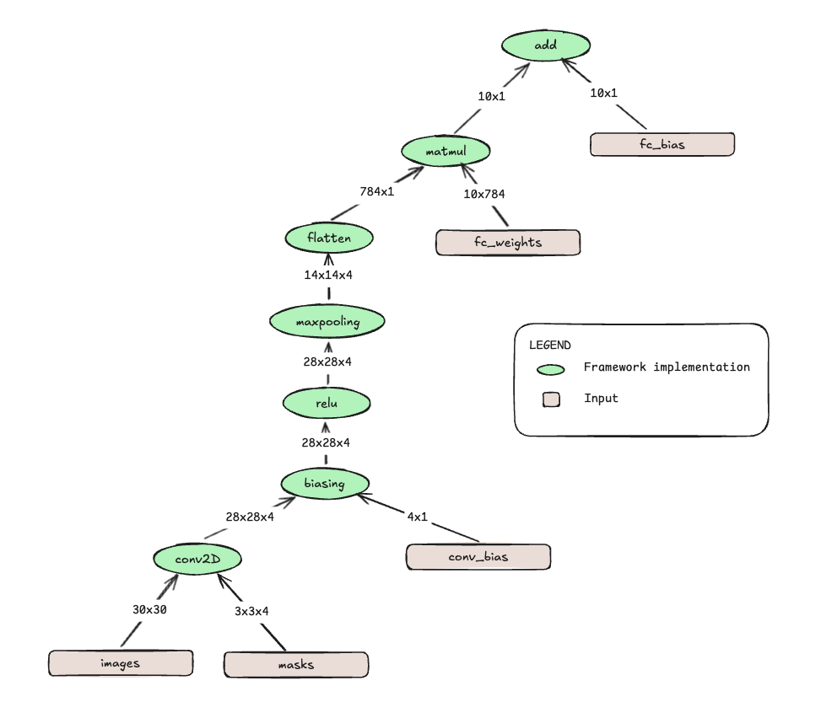
Naive Implementation
Implementation
Matrix Module
Defines struct and handles memory management (e.g., malloc_matrix, free_matrix, print_matrix)
Input/Output Module
Defines struct and loads weights and image data (e.g., malloc_io, free_io, io_to_matrix, get_value)
TensorFlow Module
Implements basic functions like add, conv2d, relu
Timer Module
Provides timing functions to measure performance (start_timer, stop_timer, delta_time_us, delta_time_s)
Main Modul
Integrates all modules, runs the AI graph, and logs performance metrics

Slide 7
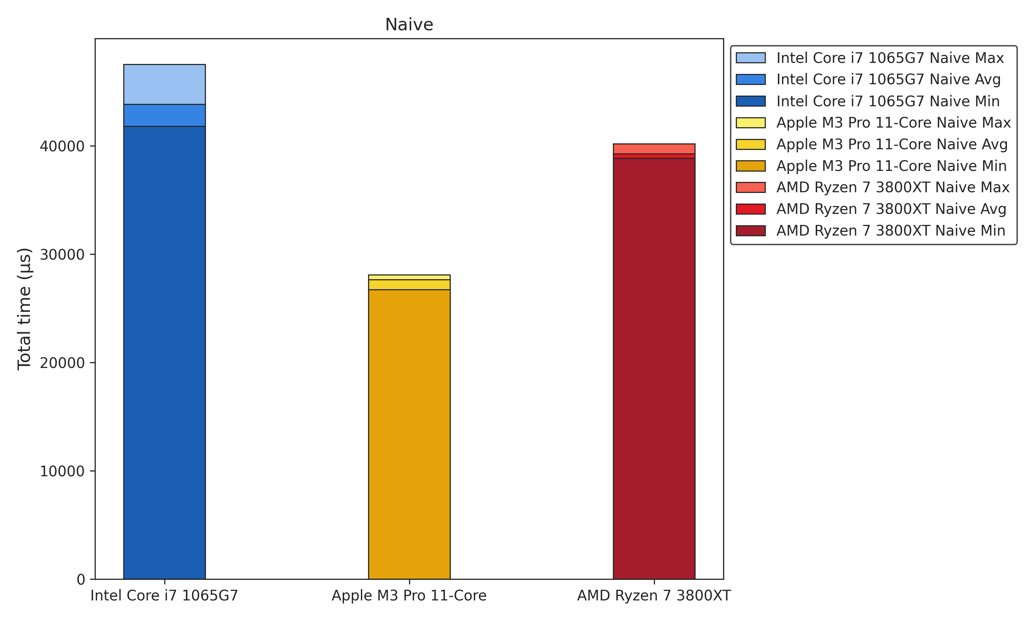
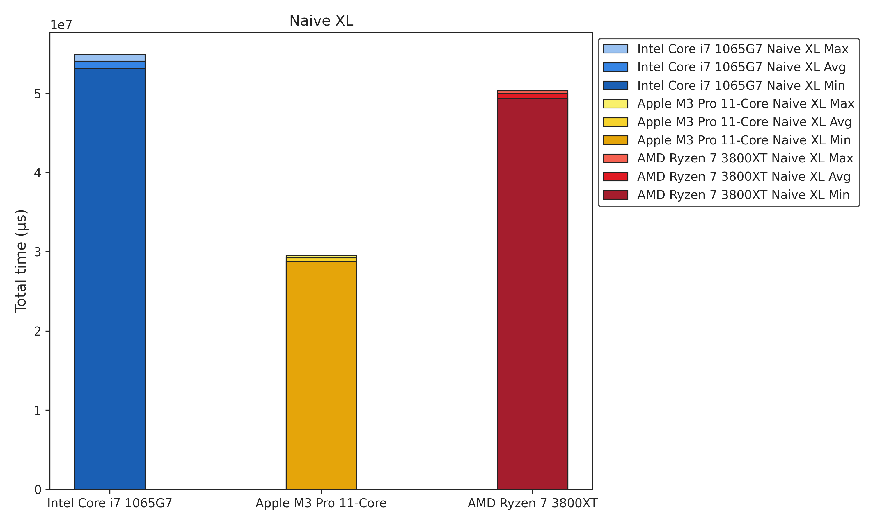
Naive Implementation
Benchmarks

Slide 8
Multithreading

Slide 9
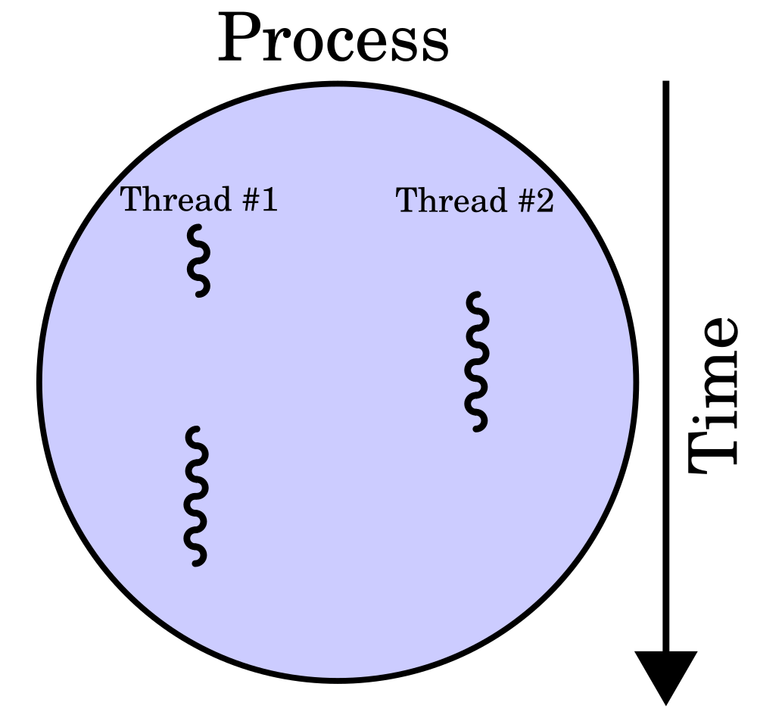
Multithreading
Overview
Multithreading
Concurrent Execution
Allows multiple tasks to run simultaneously in a program
Increased Efficiency
Utilizes CPU resources better, reducing idle time
Faster Performance
Helps improve application responsiveness and speed
Pthreads
POSIX Threads
A standardized API for thread management
Cross-Platform
Works on most Unix-like systems (Linux, macOS)
Thread Control
Provides tools for creating, managing, and synchronizing threads

Slide 10

Multithreading
Anticipated Benefits
Anticipated Benefits
Faster Processing
Speeds up data processing
Better Resource Utilization
Leverages multi-core processors for parallelism
Scalability
Makes it easier to scale the system to handle large AI models and datasets

Slide 11
Multithreading
Initial Implementation
Proof of Concept
Independent Thread Creation
Each function created and joined its own threads
Thread Pool Implementation
Thanks to the suggeestion of Philipp Holzinger :)
Optimized Thread Lifecycle
Threads are created once at the start and joined once at the end
Task Management
A GAsyncQueue is used to manage tasks efficiently
Poison Pill Mechanism
Threads continuously execute tasks until they receive a "poison pill" to terminate
void create_mt(long threads) {
THREADS = threads;
if(queue == NULL) {
queue = g_async_queue_new();
}
pthread_mutex_init(&mutex, NULL);
pthread_cond_init(&cond, NULL);
mt_arg *mt = malloc(THREADS * sizeof(mt_arg));
for(long i = 0; i < THREADS; i++) {
mt[i].idx = i;
pthread_create(&tids[i], NULL, start_mt, &mt[i]);
}
}

Slide 12
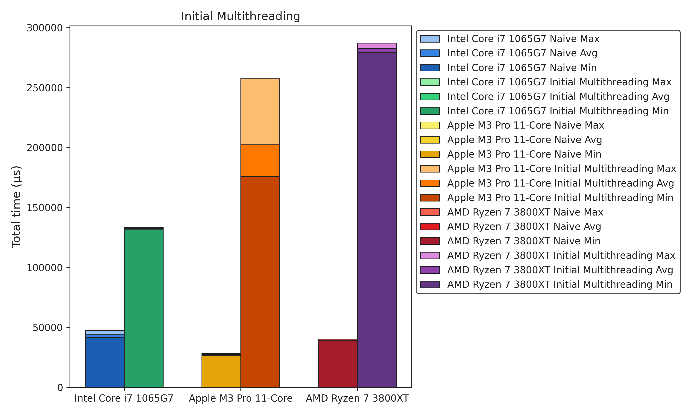
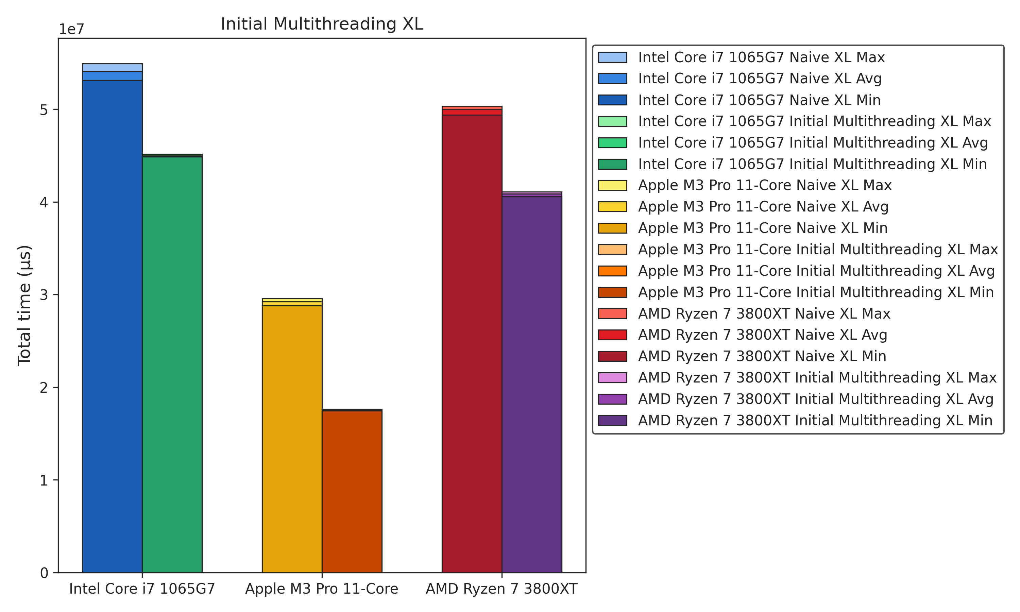

Multithreading
Benchmarks
+458%
-22%

Slide 13
Multithreading
Optimized Implementation
Smart Multithreading Implementation
Problem: Overhead exceeded performance gains for some functions
Change: Multithreading used only for sufficiently large tasks
Optimized mt_arg
Problem: mt_arg caused high memory and copy overhead
Change: Reduced mt_arg size
Cache Optimization
Problem: Poor cache performance due to inefficient thread distribution
Change: Optimized task allocation
Dedicated Multithreading Class
Problem: Image processing couldn’t be multithreaded
Change: Created a dedicated thread management class
Multithreaded Image Processing
Problem: Sequential image processing was inefficient
Change: Added concurrent image processing
0
1
0
1
0
0
1
1

Slide 14
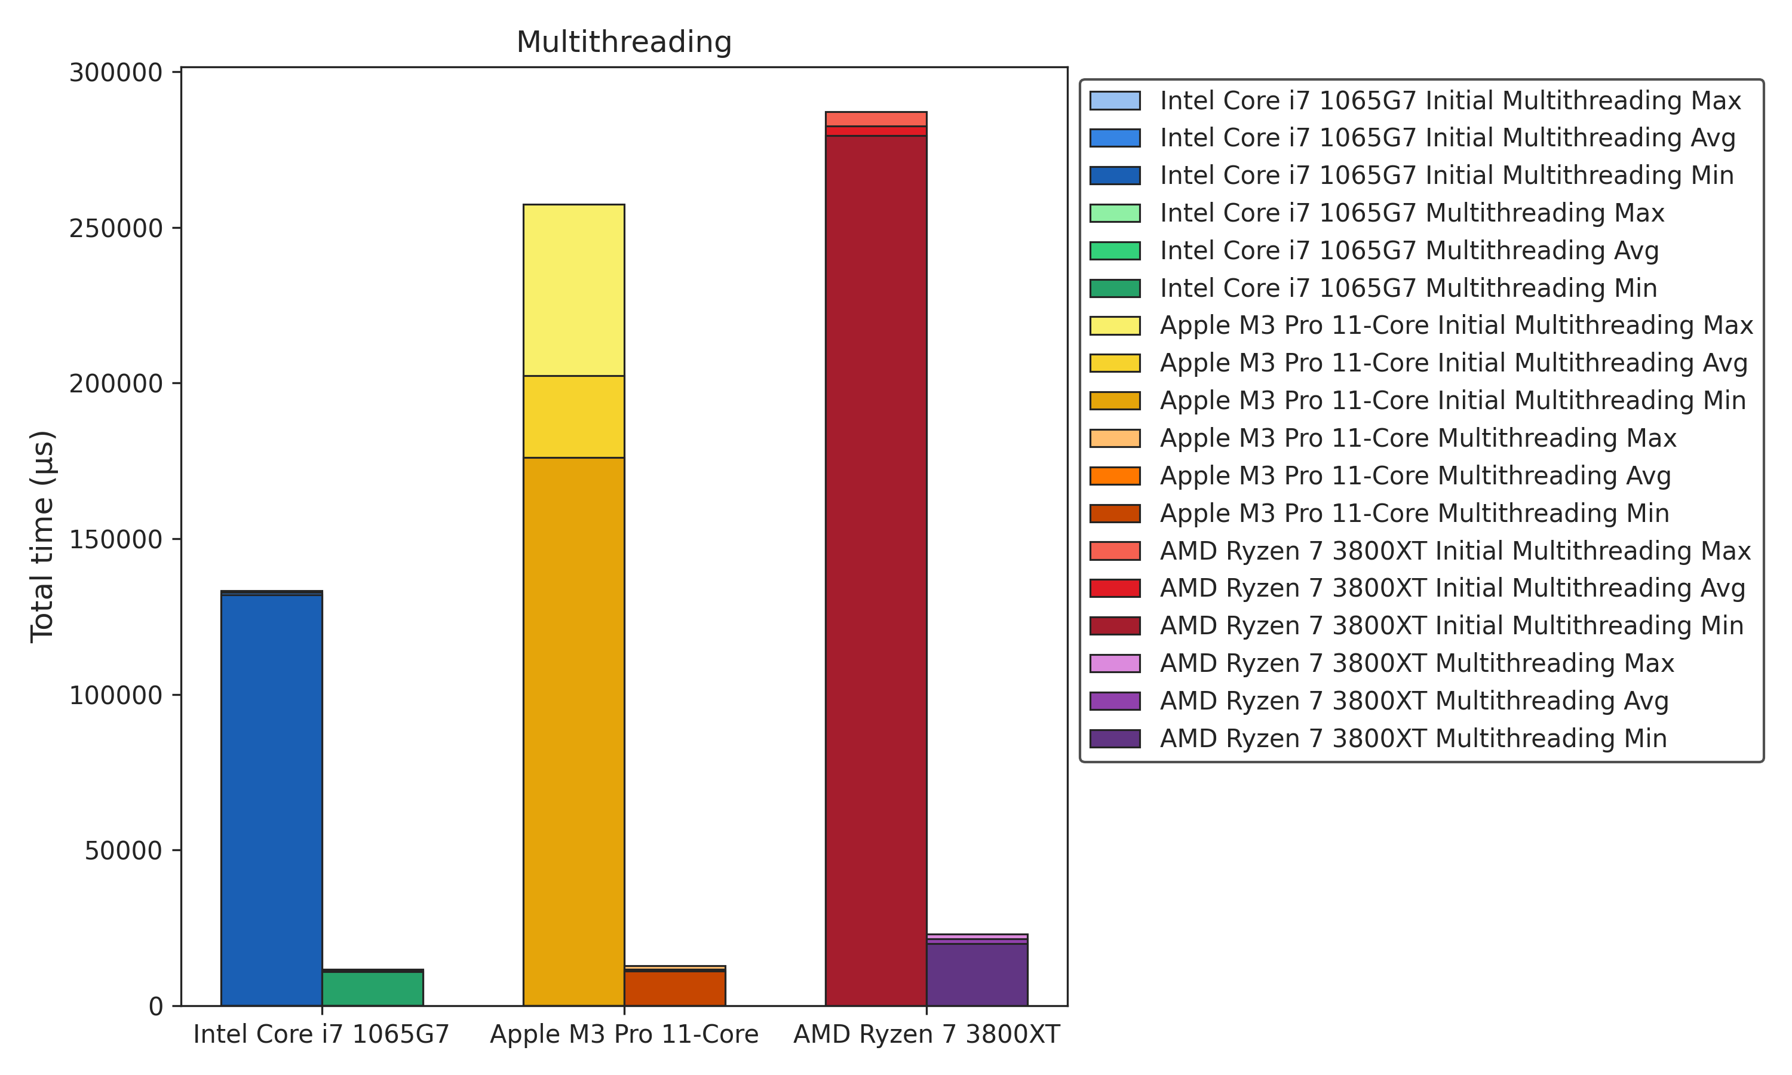
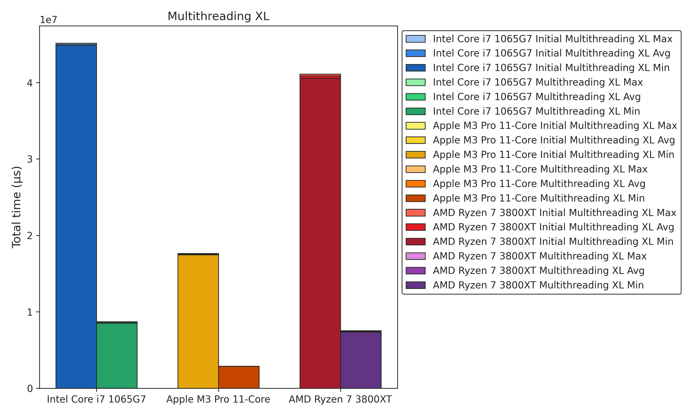
Multithreading
Benchmarks
-93%
-82%

Slide 15
OpenMP

Slide 16
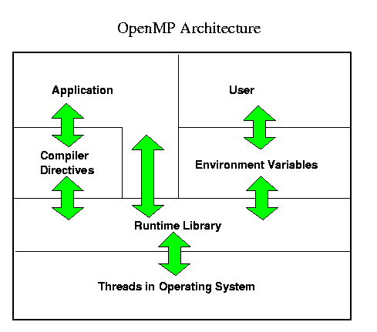
OpenMP
Open Multi-Processing
OpenMP
API for parallel programming in C and C++ for several CPU- and GPU-architectures
Simplifies parallel programming by managing threading on compiler side
Basic Function
Uses pragmas (compiler directives) to define parallel regions in code
Distributes work across cores based on current load
Compiler handels most parallelization details, reducing transparency and flexibilty

Slide 17
OpenMP
Implementation 1/ 2
Compiler Directives
#pragma omp parallel
#pragma omp for
#pragma omp simd
Library Functions
omp_set_num_threads()
omp_get_num_threads()
Environment Variables
OMP_NUM_THREADS
/*
* @param a: Input-Matrix a
* @param b: Input-Matrix b
* @param c: Output-Matrix c
* @param mt: Multithreading object
* @return: Matrix c as a result of a + b
*/
matrix *add(void *a, void *b, matrix *c, mt *instance) {
#pragma omp parallel for collapse(2)
for(int i = 0; i < c->x; i++) {
for(int j = 0; j < c->y; j++) {
// ...
}
}
}

Slide 18
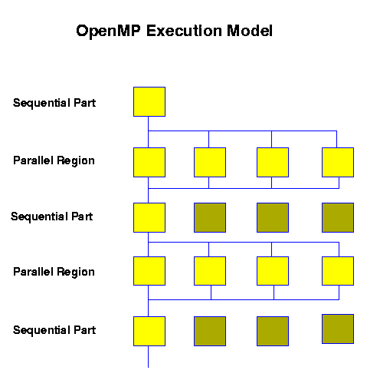
OpenMP
Implementation 2/ 2
Compiler Flags (Depending On Architecture)
AMD: -Xcompiler -fopenmp
Arm: -Xclang -fopenmp
Intel: -Xcompiler -qopenmp
Offload Targets
Executes computations on devices like GPUs or specialized hardware
Requires compiler support
Warning
warning: loop not vectorized: the optimizer was unable to perform the requested transformation; the transformation might be disabled or specified as part of an unsupported transformation ordering [-Wpass-failed=transform-warning] 1 warning generated.

Slide 19
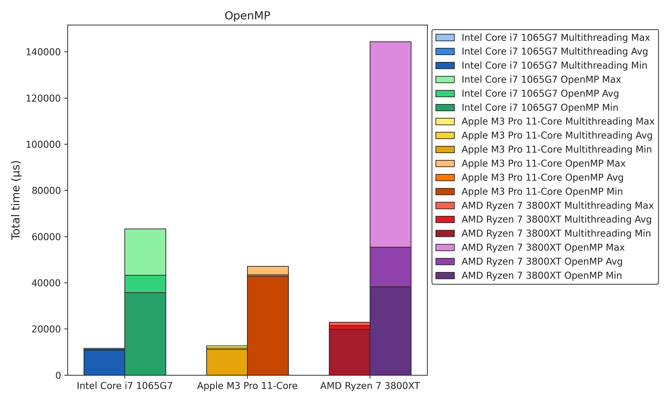
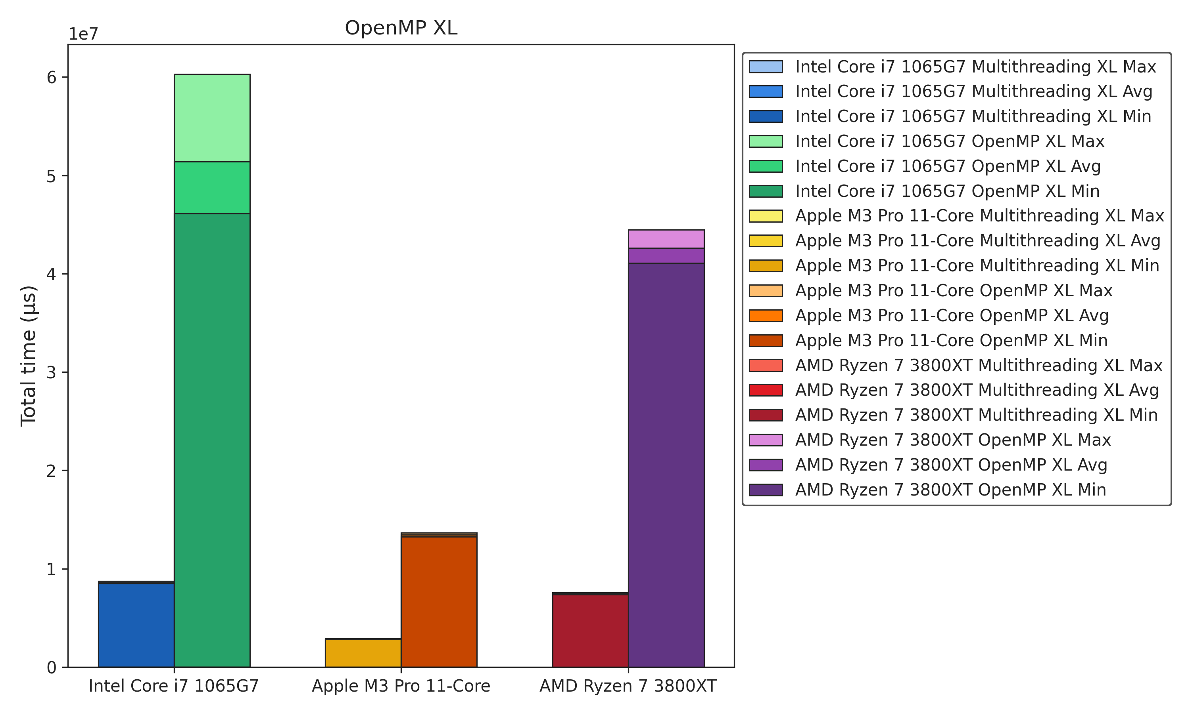
OpenMP
Benchmarks
+220%
+468%

Slide 20
Compiler & Build Tools

Slide 21


Compiler
ICPX vs. Clang
ICPX (Intel oneAPI DPC++/C++ Compiler)
Former Name: Intel C++ Compiler (ICPC)
Developer: Intel
Primary Focus: Optimized for Intel hardware (CPUs, GPUs, FPGAs)
License: Freeware, Proprietary (under Intel’s terms)
Supported Platforms: Windows, Linux
Key Features
Supports threading with Intel oneAPI Threading Building Blocks (TBB), OpenMP, and native threads
Supports proprietary hardware features
Integration with Intel libraries for performance optimizations, such as Intel MKL and IPP
Clang
Former Developer: Apple
Developer: LLVM Project
Primary Focus: Supports a wide variety of architectures (x86, ARM, etc.)
License: Open Source (Apache License 2.0)
Supported Platforms: Windows, Linux, macOS, and more
Key Features:
Supports OpenMP and native threads
Great for cross-compiling across platforms
Extensive tooling support for debugging and static analysis

Slide 22
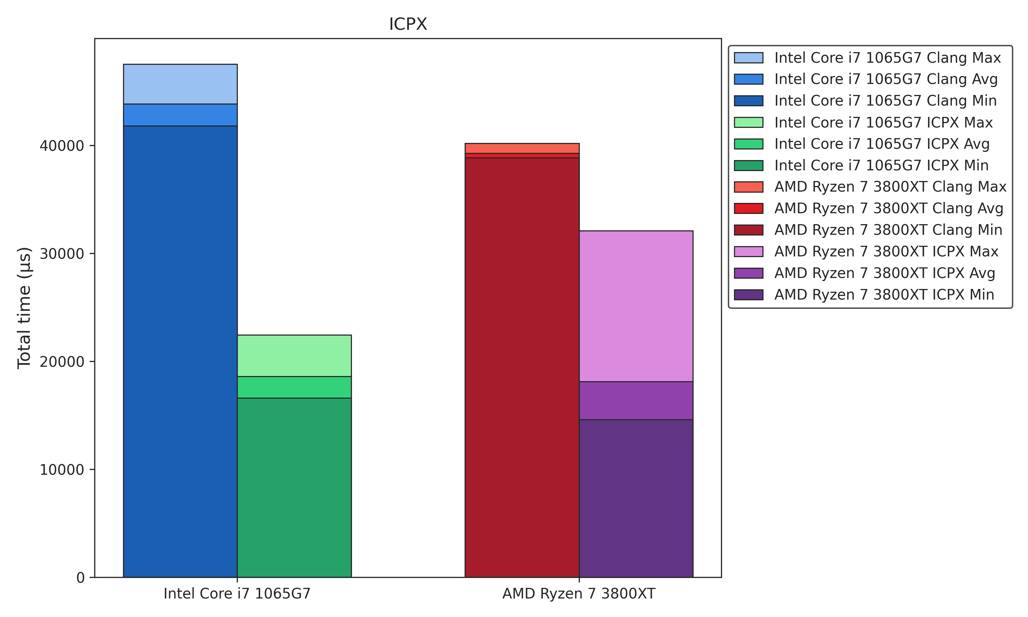
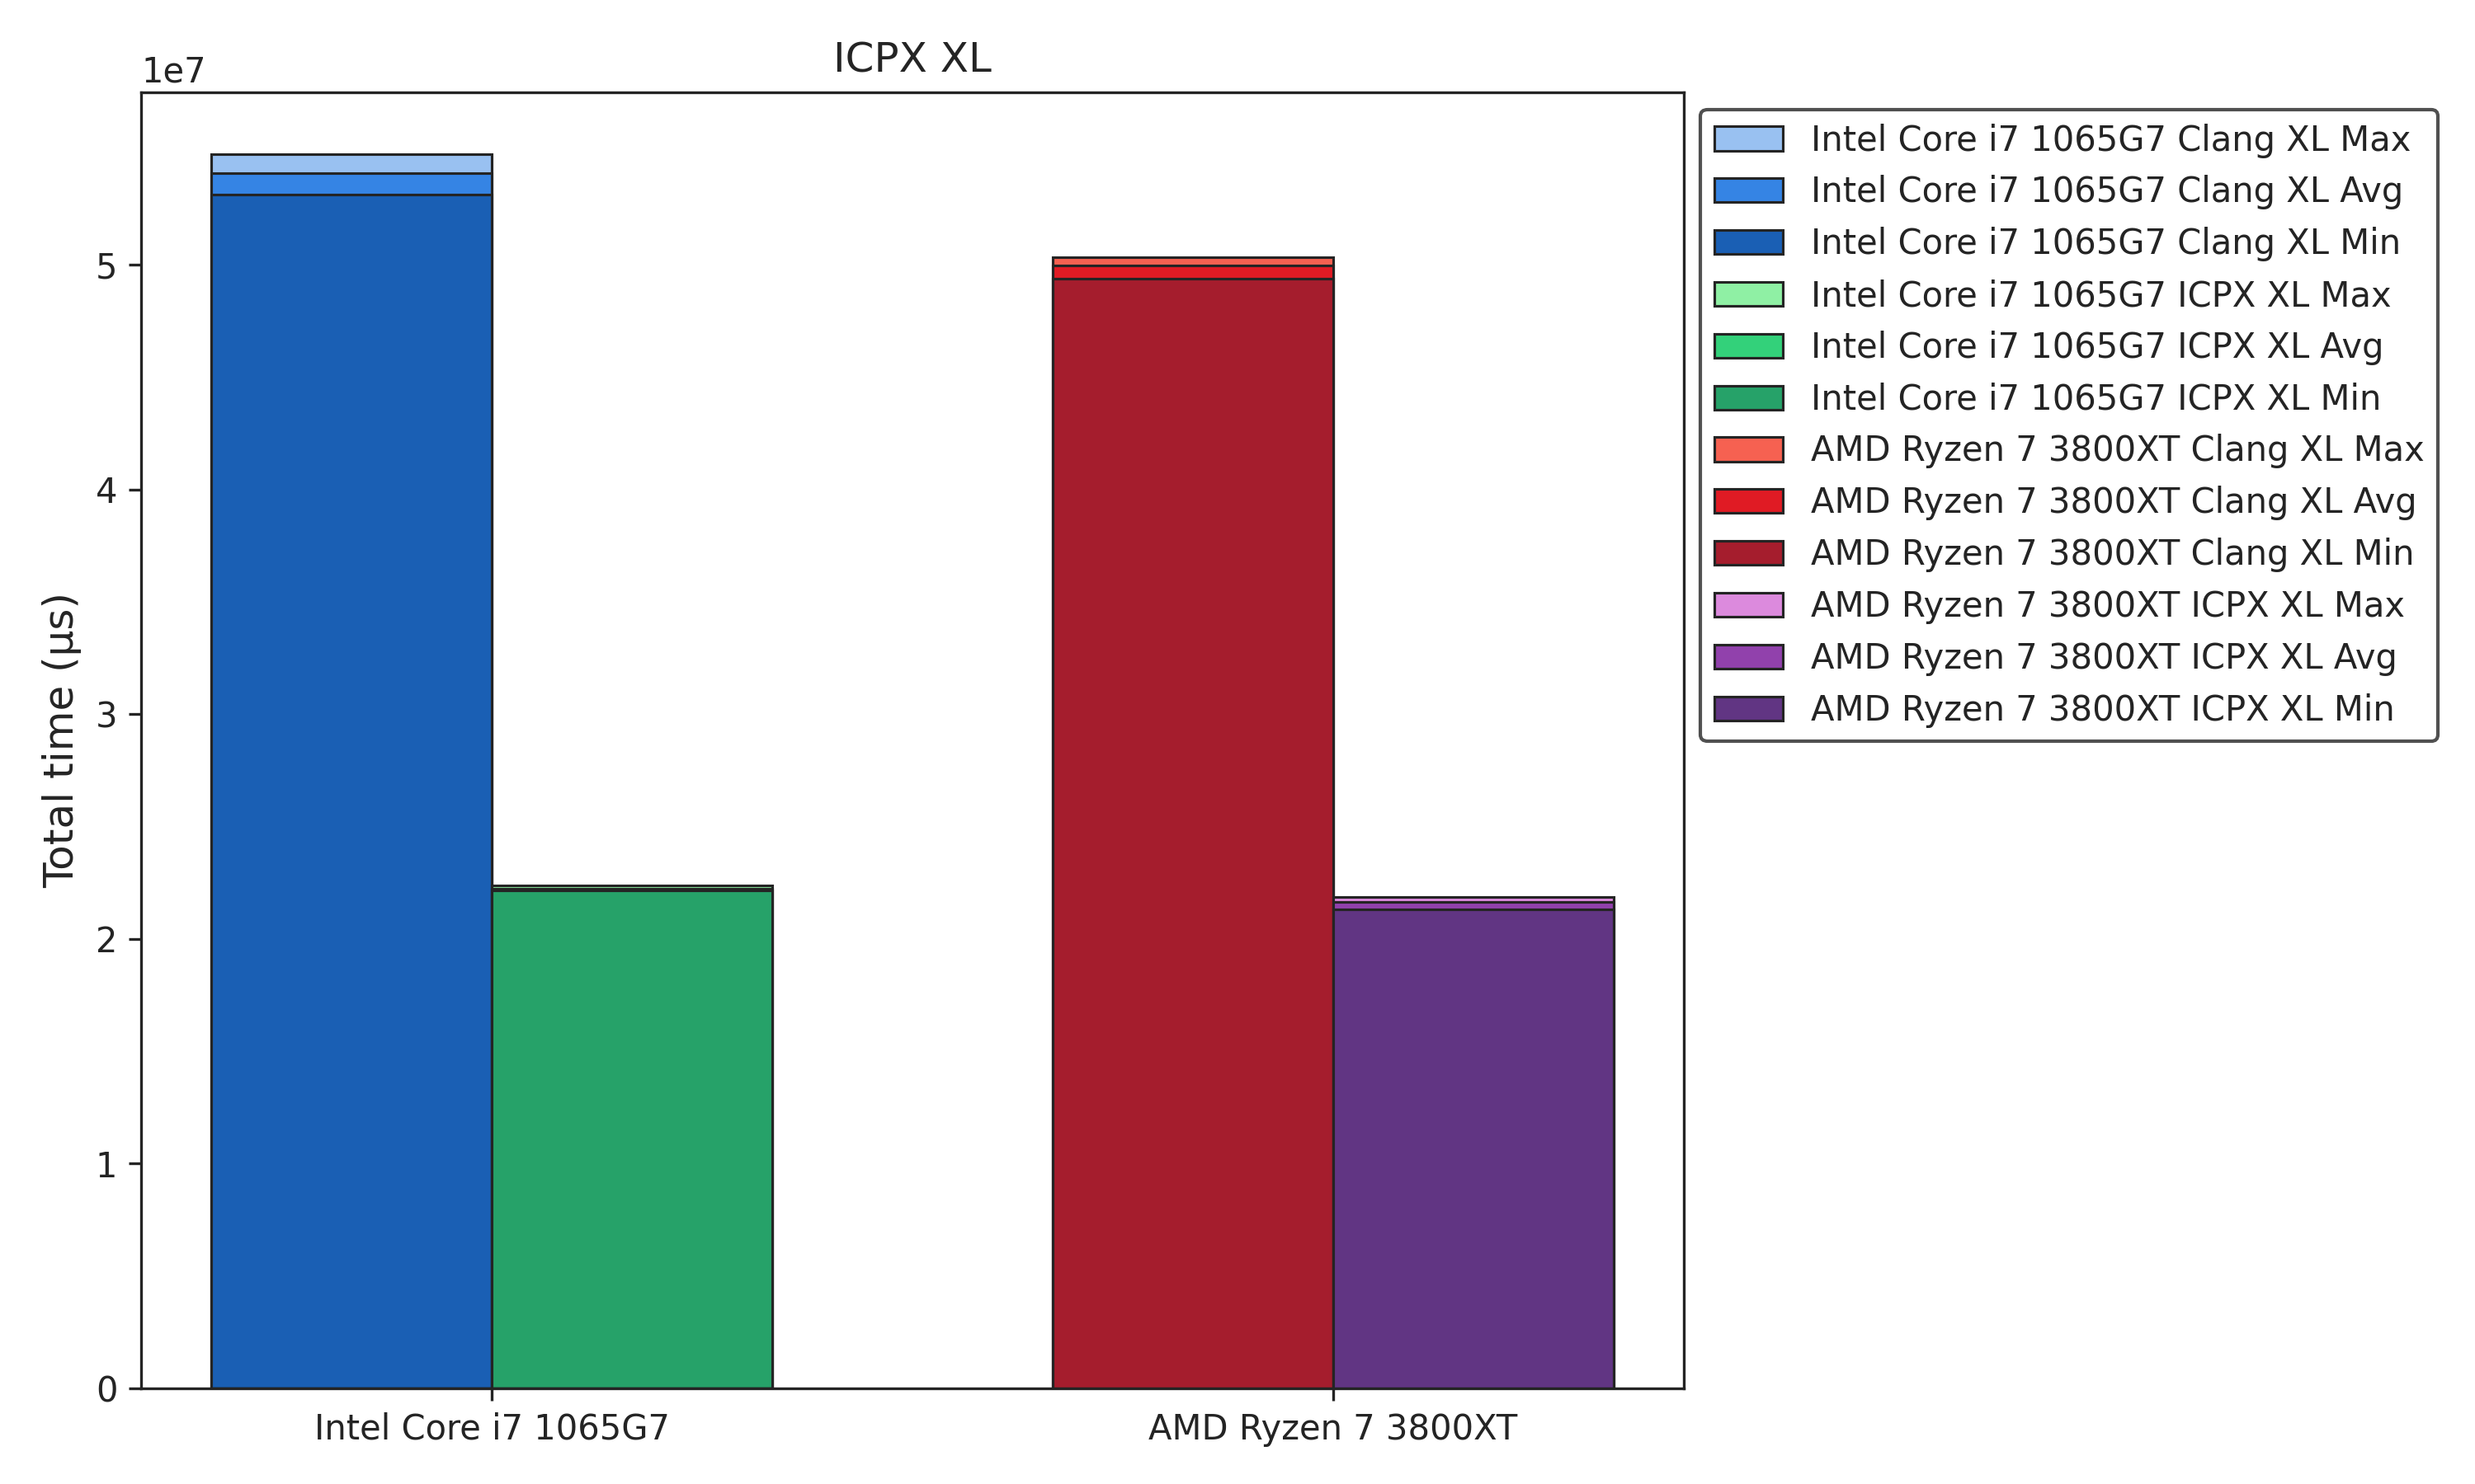
Compiler
Benchmarks 1/ 2
-58%
-59%

Slide 23
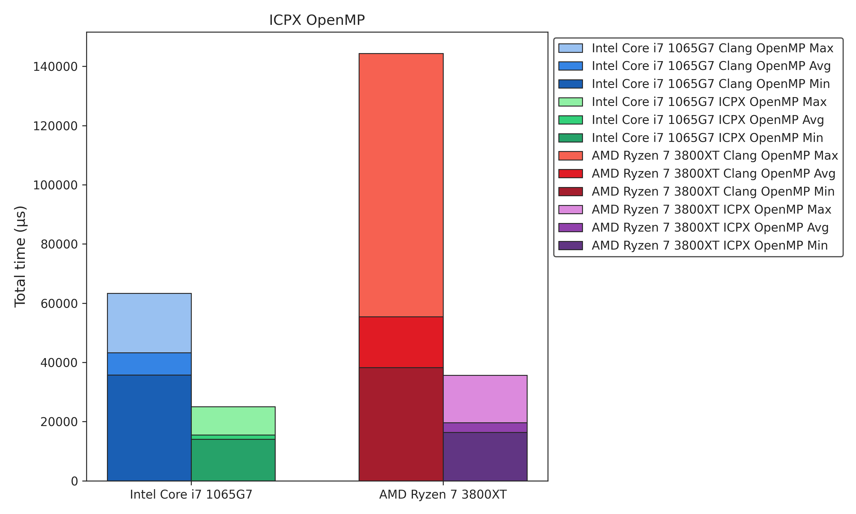
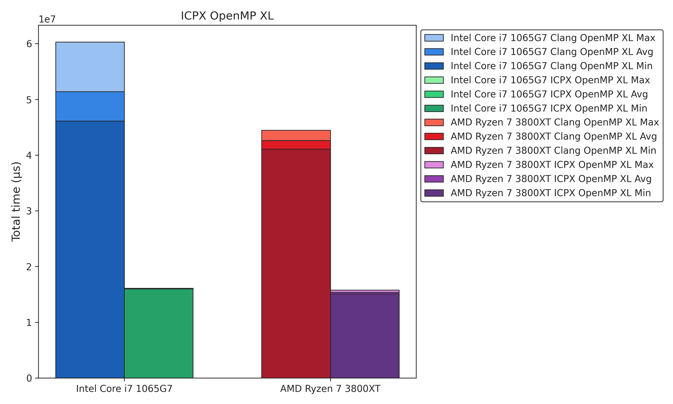
Compiler
Benchmarks 2/ 2
-64%
-69%

Slide 24
Build Tools
Dialog 1/ 2
Reasons
Reduces Target Bloat
Helps avoid exceeding the current 26 Makefile targets
Simplifies Config Selection
Handles over 1024 possible CFLAG combinations
Improves User Experience
Enhances usability for AI framework users
Dialog
Create Interactive UIs
Build text-based interfaces in shell scripts
Multiple Input Types
Includes menus, checklists, and forms
Enhanced UX
Streamlined and user-friendly command-line interface

Slide 25

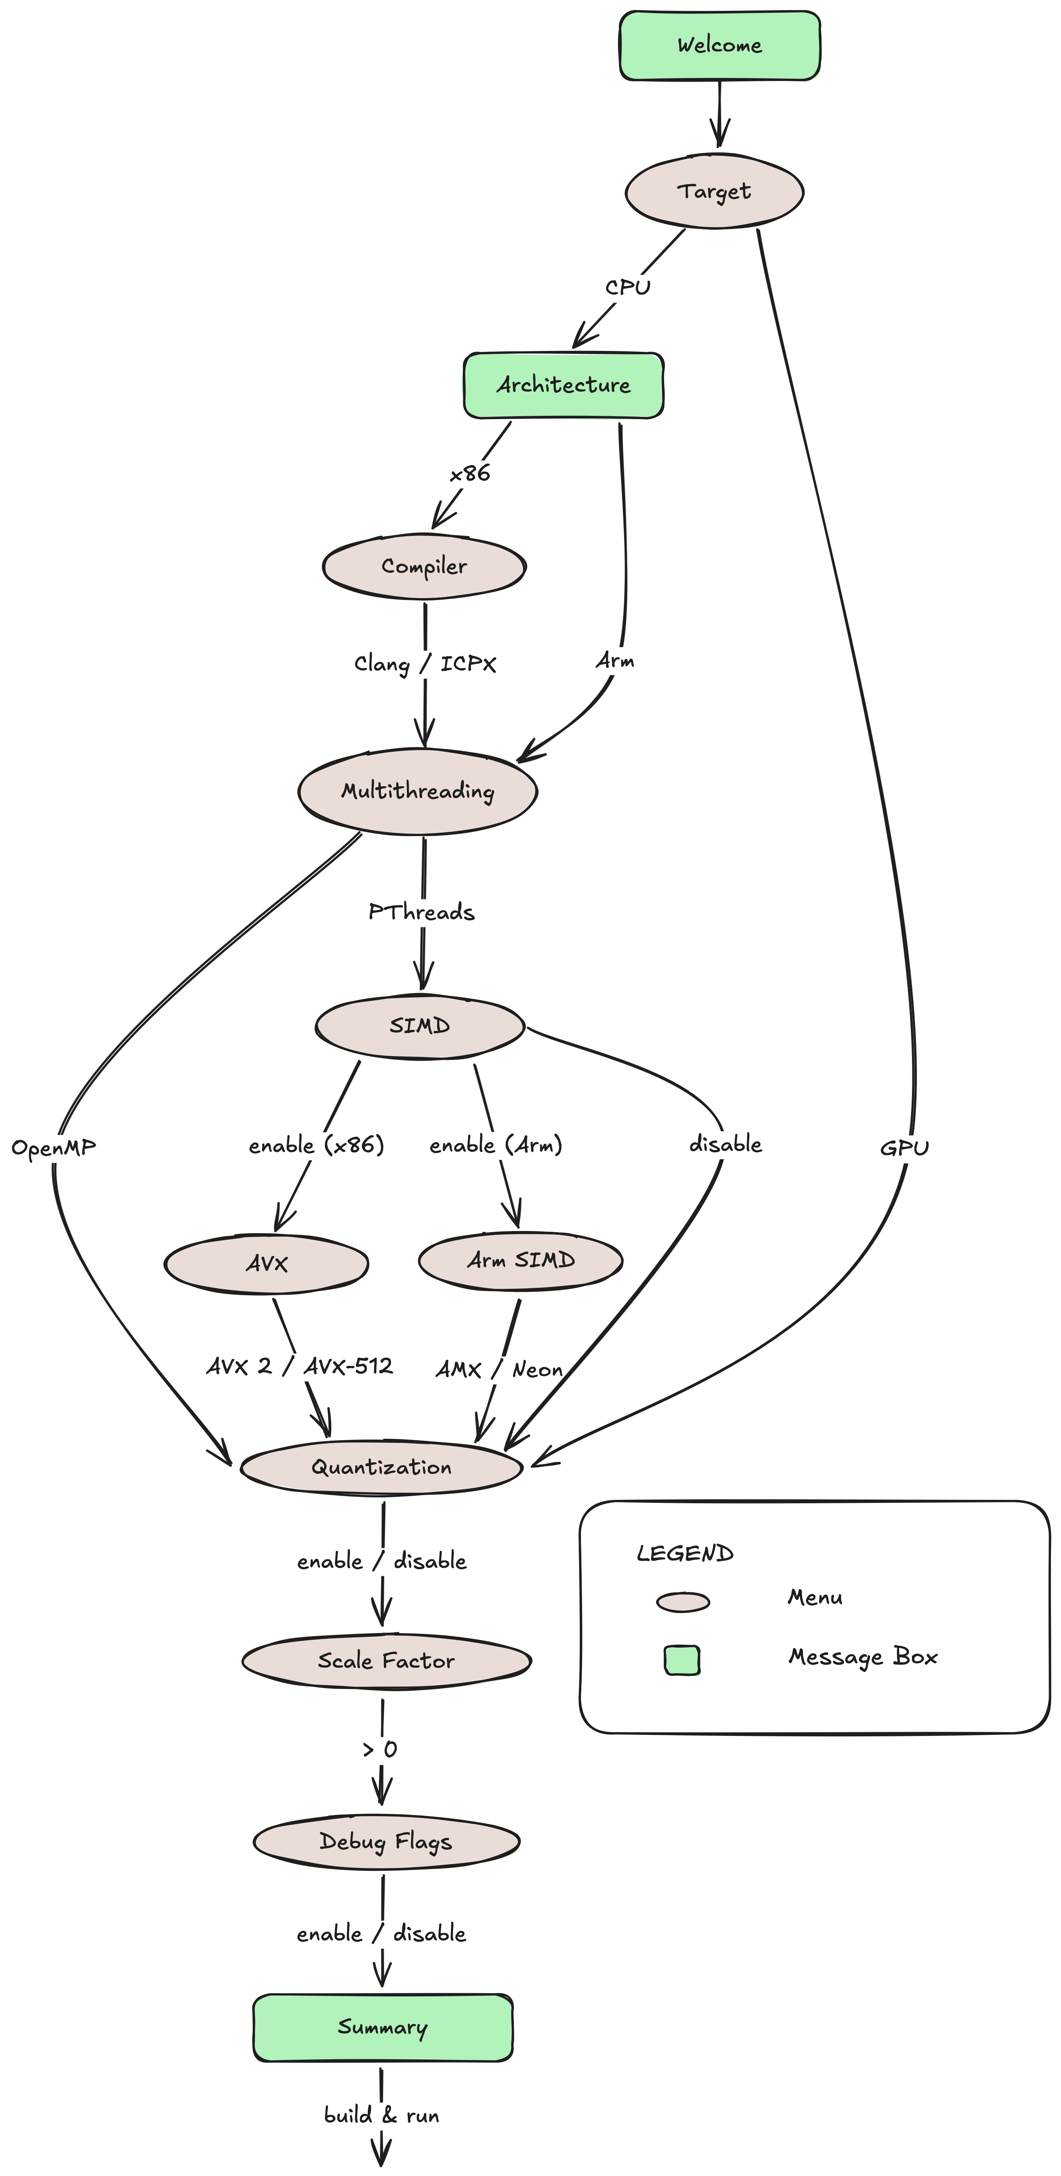
Build Tools
Dialog 2/ 2
Implemented flowchart logic in a Bash script
Integrated the script into a Makefile target

Slide 26
Build Tools
Dialog
GUI-Oriented
Optimized
Options
and
Settings
Engine

Slide 27
SIMD

Slide 28
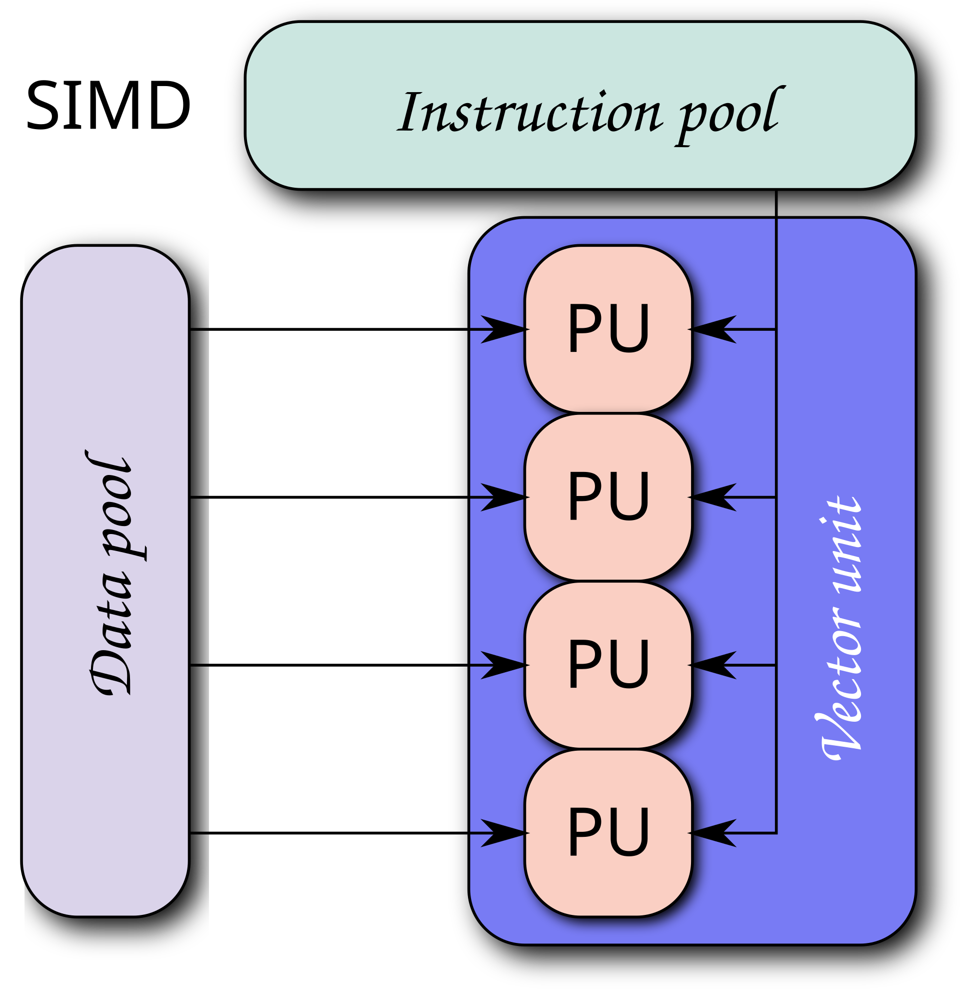
SIMD
Single Instruction Multiple Data
Parallel Processing
Enables a single instruction to operate on multiple data elements at once, boosting computational efficiency
Vectorization
Utilizes vector registers, which can hold several data values, to perform simultaneous operations on them in parallel
Broad CPU Support
Different processors have their own SIMD extensions
AMD: SSE and AVX2
Arm: Neon
Intel: SSE, AVX2, and AVX-512

Slide 29
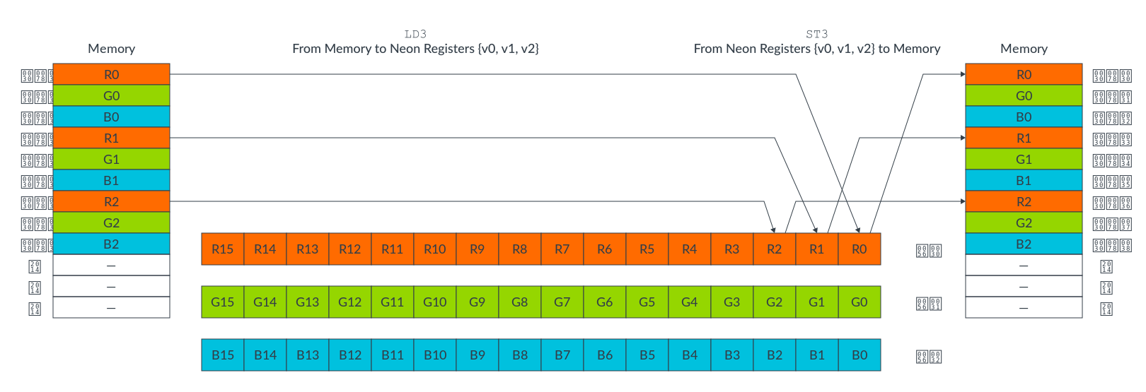
Arm Optimization
Neon
Overview
SIMD unit for Arm processors
Introduced in ARMv7 (currently available in ARMv9)
Optimizes data manipulation using 32x128-bit vector registers
Functions are available in C/ C++ via arm_neon.h
Useful Features
Supports various data types
Handles unaligned data, but decreses performance
Includes vaddv (Vector Add Across Vector), enabling horizontal addition across vector element - ideal for operations like conv2d()
Benefits
Provides direct access to Neon instructions, eliminating the need for assembly code
Simplifies migration between processors (AArch32 to AArch64)

Slide 30
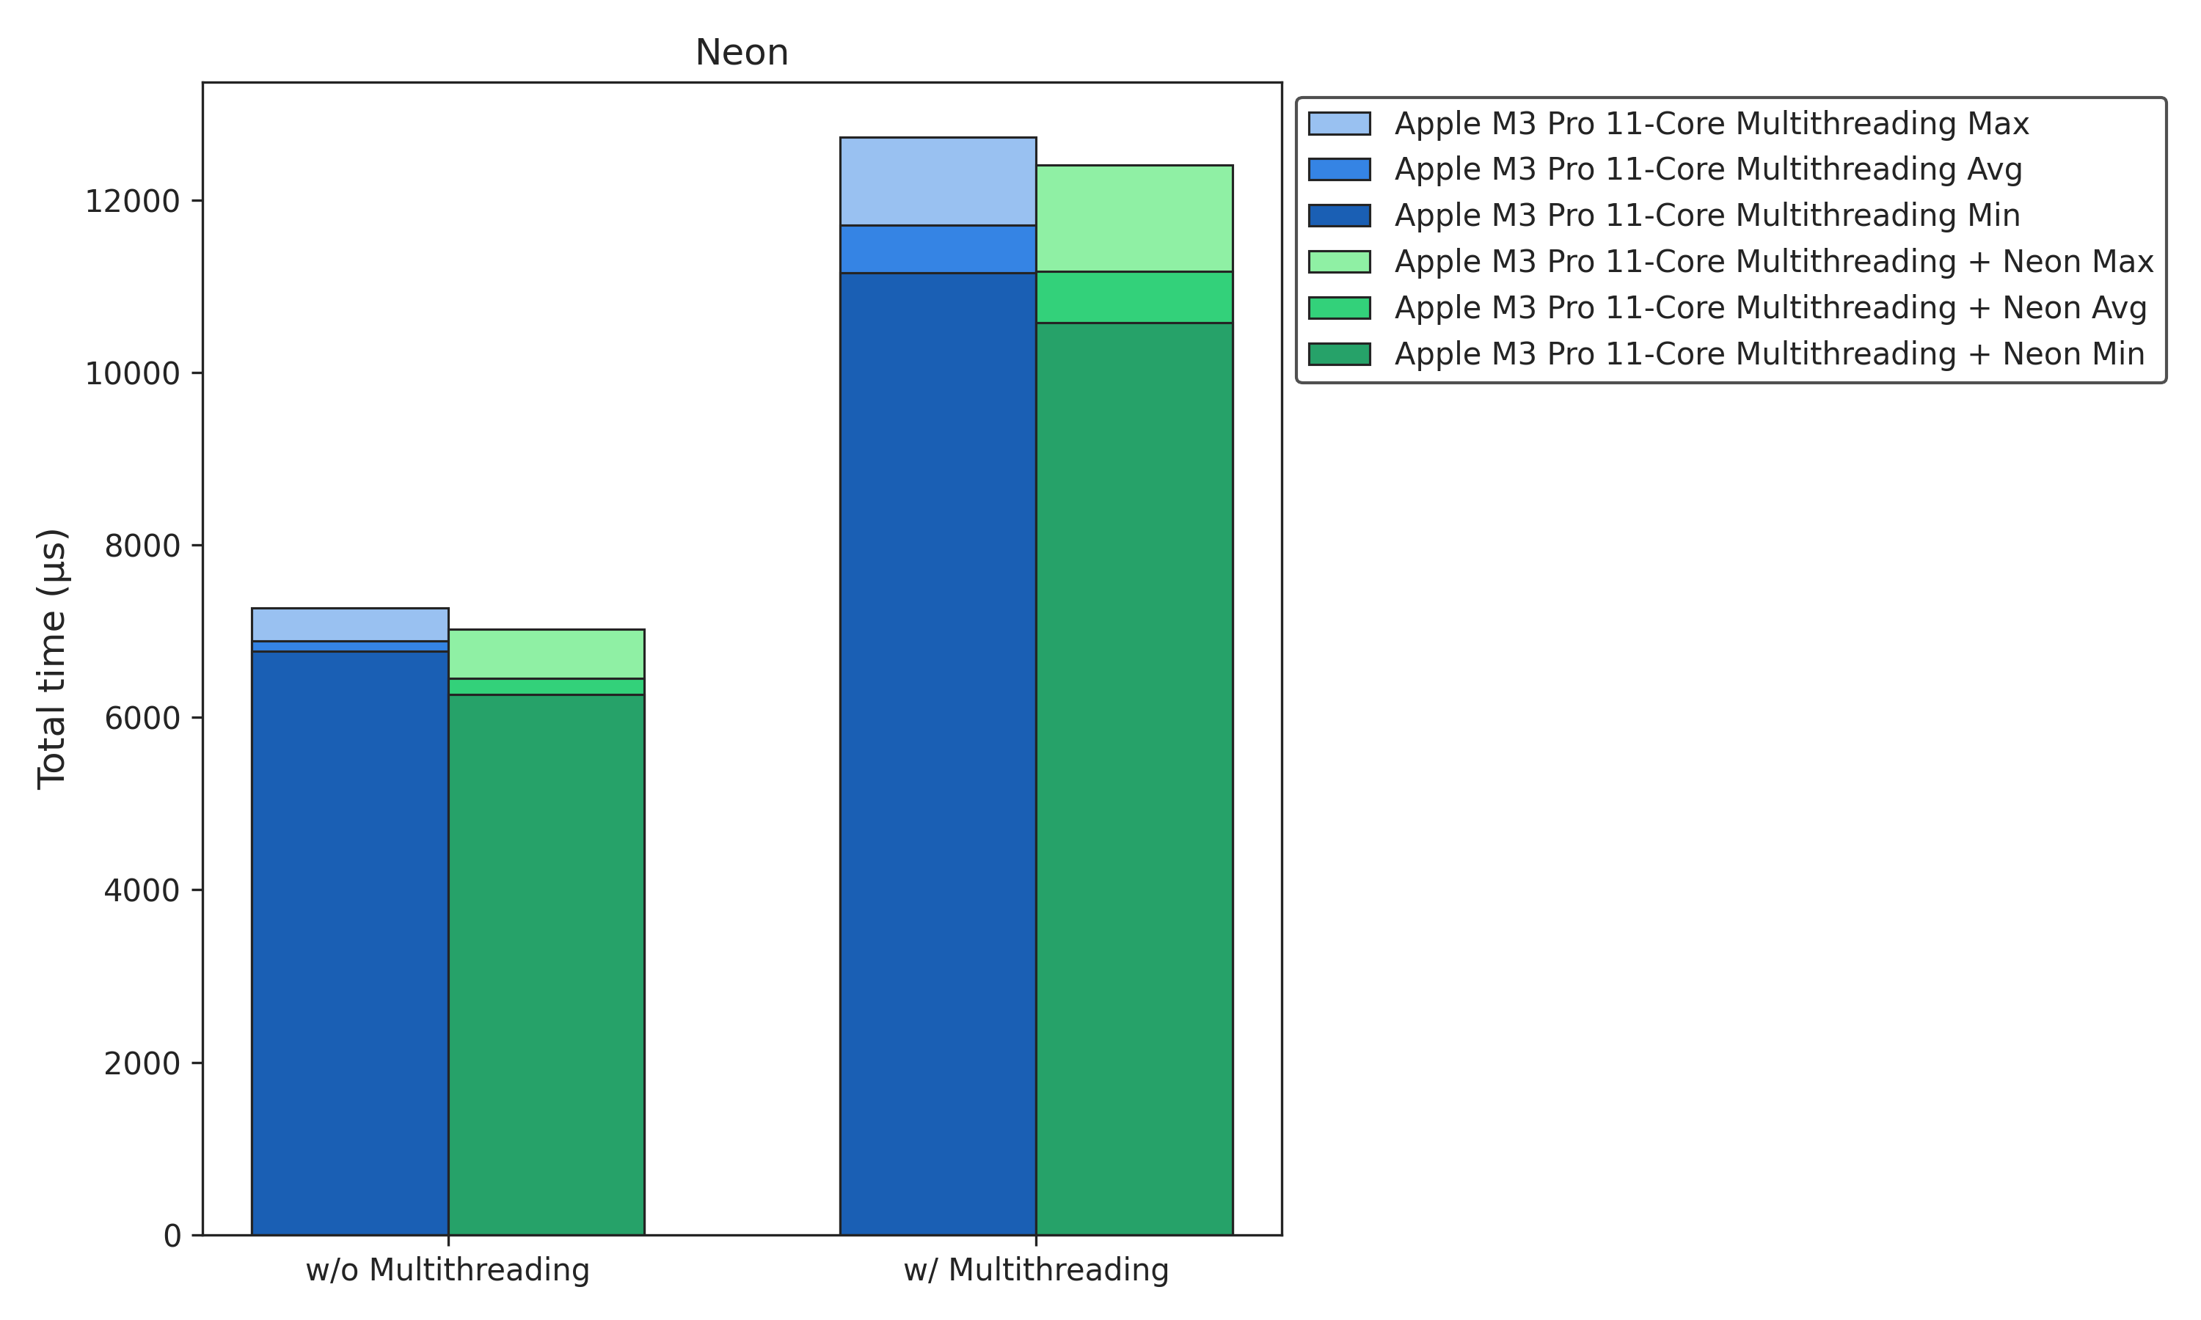
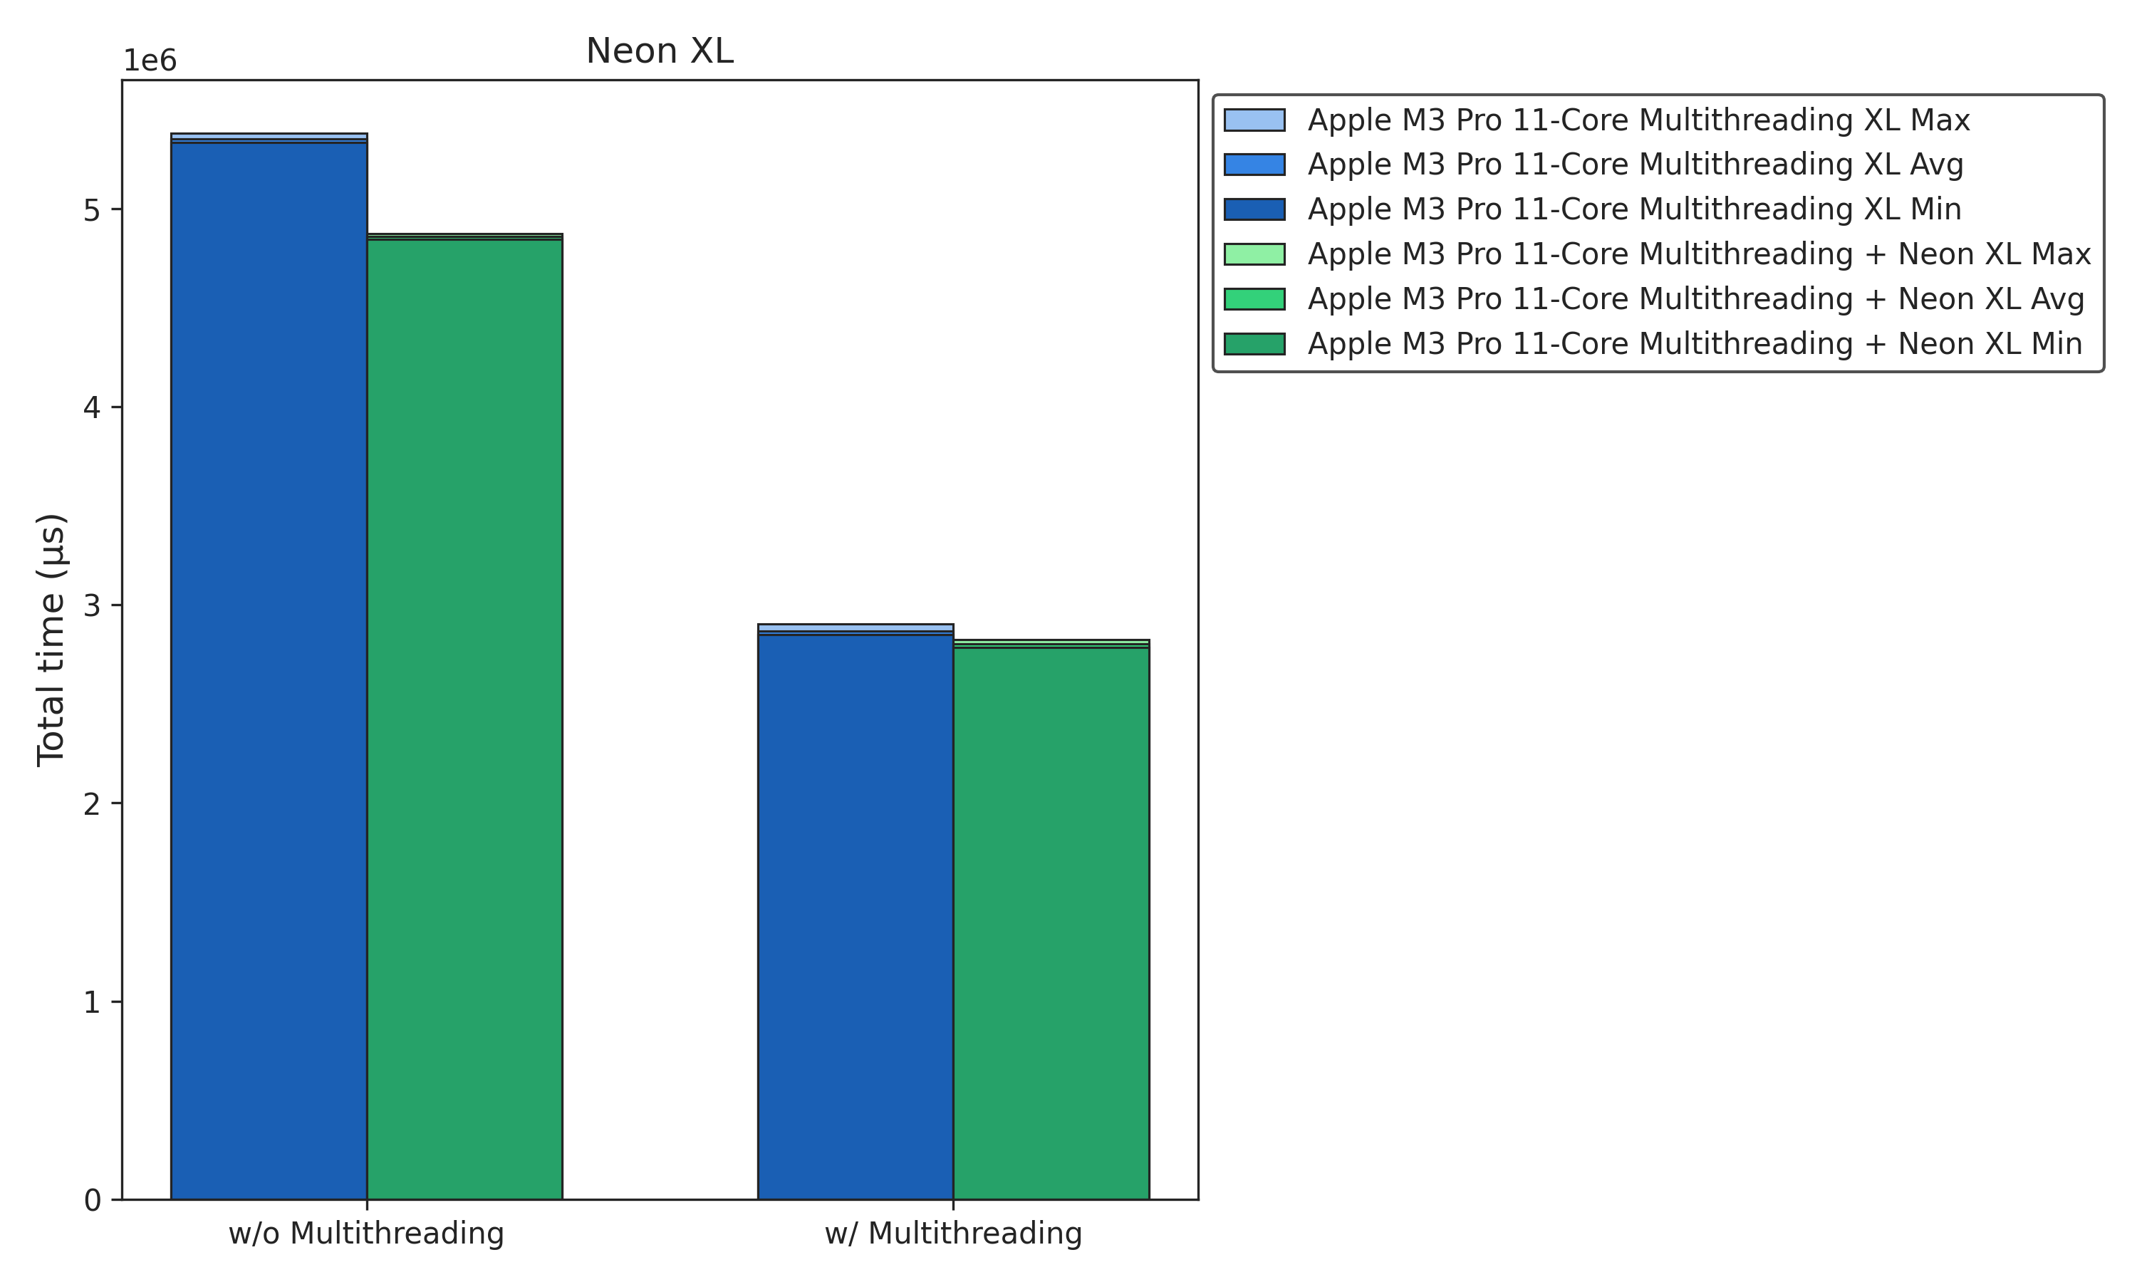
Arm Optimization
Neon Benchmarks
-5%
-7%

Slide 31
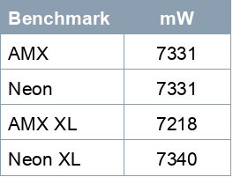
Arm Optimization
AMX
Overview
Reverse engineering of the AMX (Apple Matrix Extension) chip for Apple's ARM-based Silicon (M1, M2, etc.)
AMX Registers
X (or Y) Registers
4 source registers for computations
Containing 64 floating-point values in total
Z Registers
Serves as the accumulator or output registers
Holds a 64x64 floating-point matrix
Implementation
void matmul_simd(mt_arg *mt)
void conv2d_simd(mt_arg *mt)
AMX Instructions
Defined in aarch64.h
Implemented as macros for assembly instructions
Utilize bitmasks (bm) to define instruction behavior
Key instructions
AMX_SET() and AMX_CLR()
AMX_LDX(bm) or AMX_LDY(bm)
AMX_STZ(bm)
AMX_FMA32(bm)
Power Consumption
Manually measured with powermetrics
Average of more than ten values

Slide 32
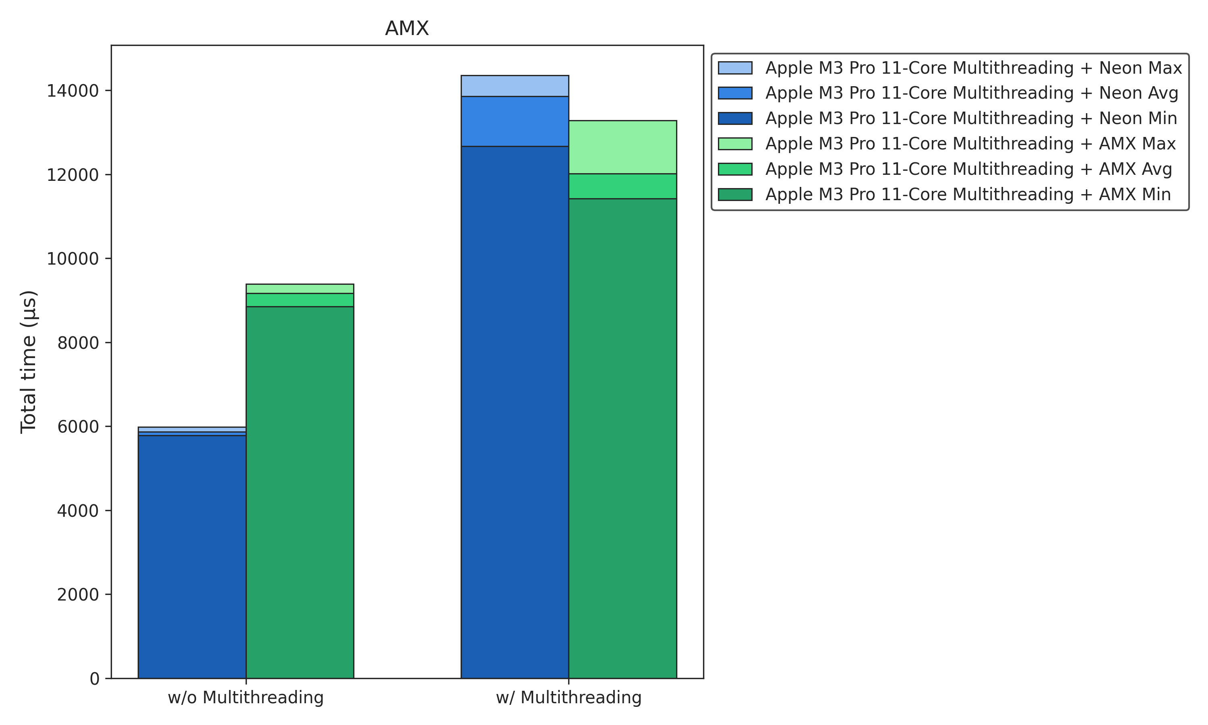
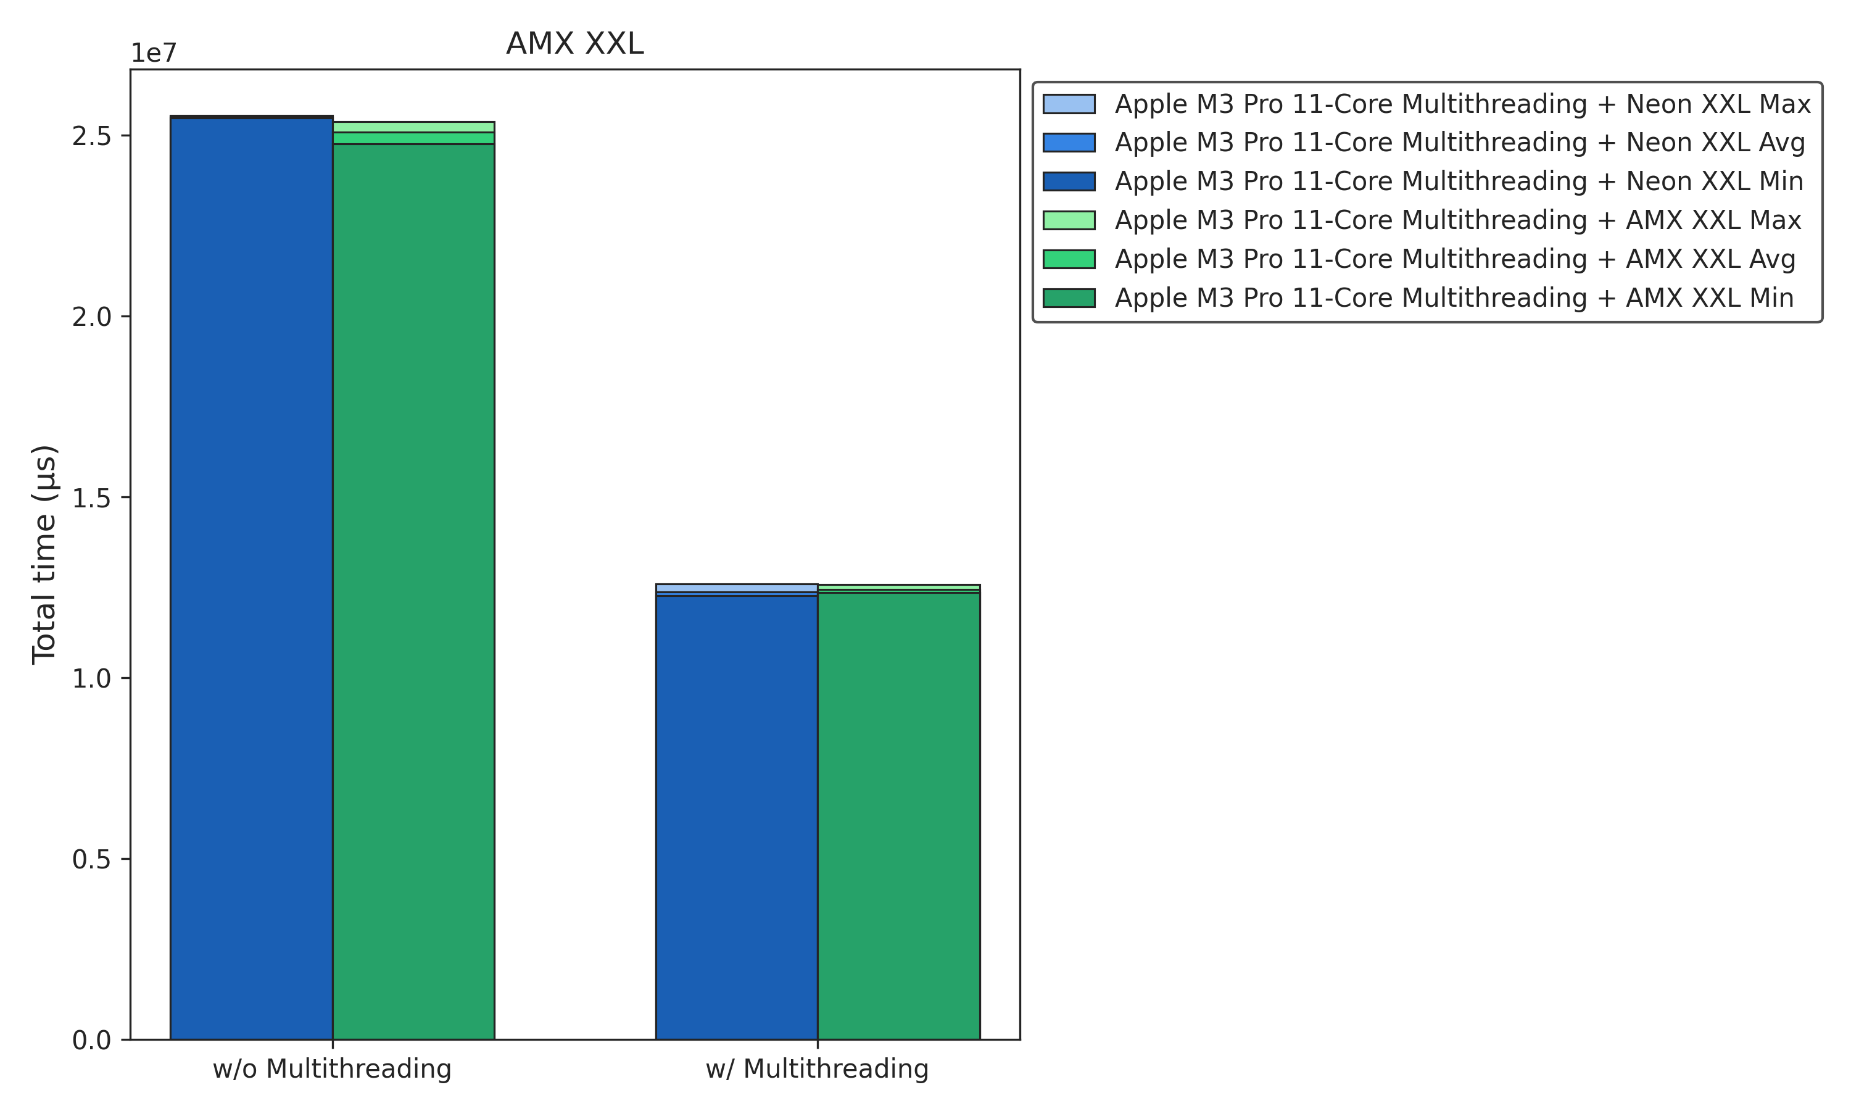
Arm Optimization
AMX Benchmarks
+7%
-1%

Slide 33

Arm Optimization
AMX Challenges
Challenges
Relying on a personal GitHub repository
Lack of Documentation:
Difficult Implementation
Difficult Troubleshooting
Limited amount of supported data types
Limited instruction set
Optimized for specific workloads

Slide 34
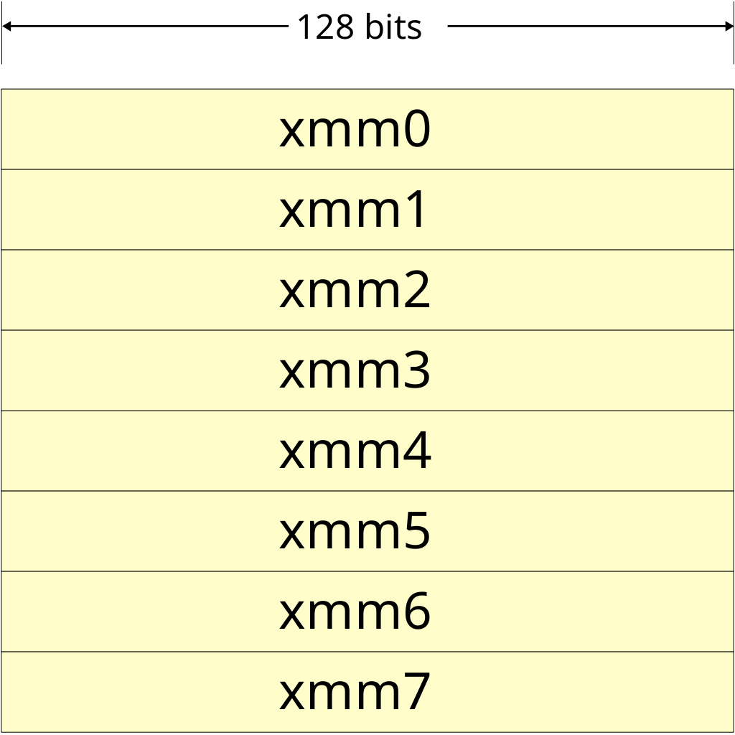
x86 Optimization
SSE (Streaming SIMD Extensions)
128-bit vector processing: Basic SIMD instructions for parallel processing
Broad compatibility: Supported on most CPUs
AVX2 (Advanced Vector Extensions 2)
256-bit vectors: Doubles the vector width for better data processing.
Needs breakdown for horizontal addition: Requires splitting vectors into two
AVX512 (Advanced Vector Extensions 512)
512-bit vectors: Processes larger data sets with greater parallelism
Intel-only: Primarily supported on Intel CPUs, not available on most AMD processors
Supports padding through masks: Eliminates the need for fallback sequential code
reduce_add: Introduces a new instruction for efficient reduction by addition
AVX2: (*mt->c)->m[get_idx(mt->i, mt->j, (*mt->c)->y)] = _mm_extract_ps(_mm_hadd_ps(_mm_hadd_ps(_mm_add_ps(_mm256_castps256_ps128(c), _mm256_extractf128_ps(c, 1)), _mm_setzero_ps()), _mm_setzero_ps()), 0);
AVX512: (*mt->c)->m[get_idx(mt->i, mt->j, (*mt->c)->y)] = _mm512_reduce_add_ps(c);

Slide 35
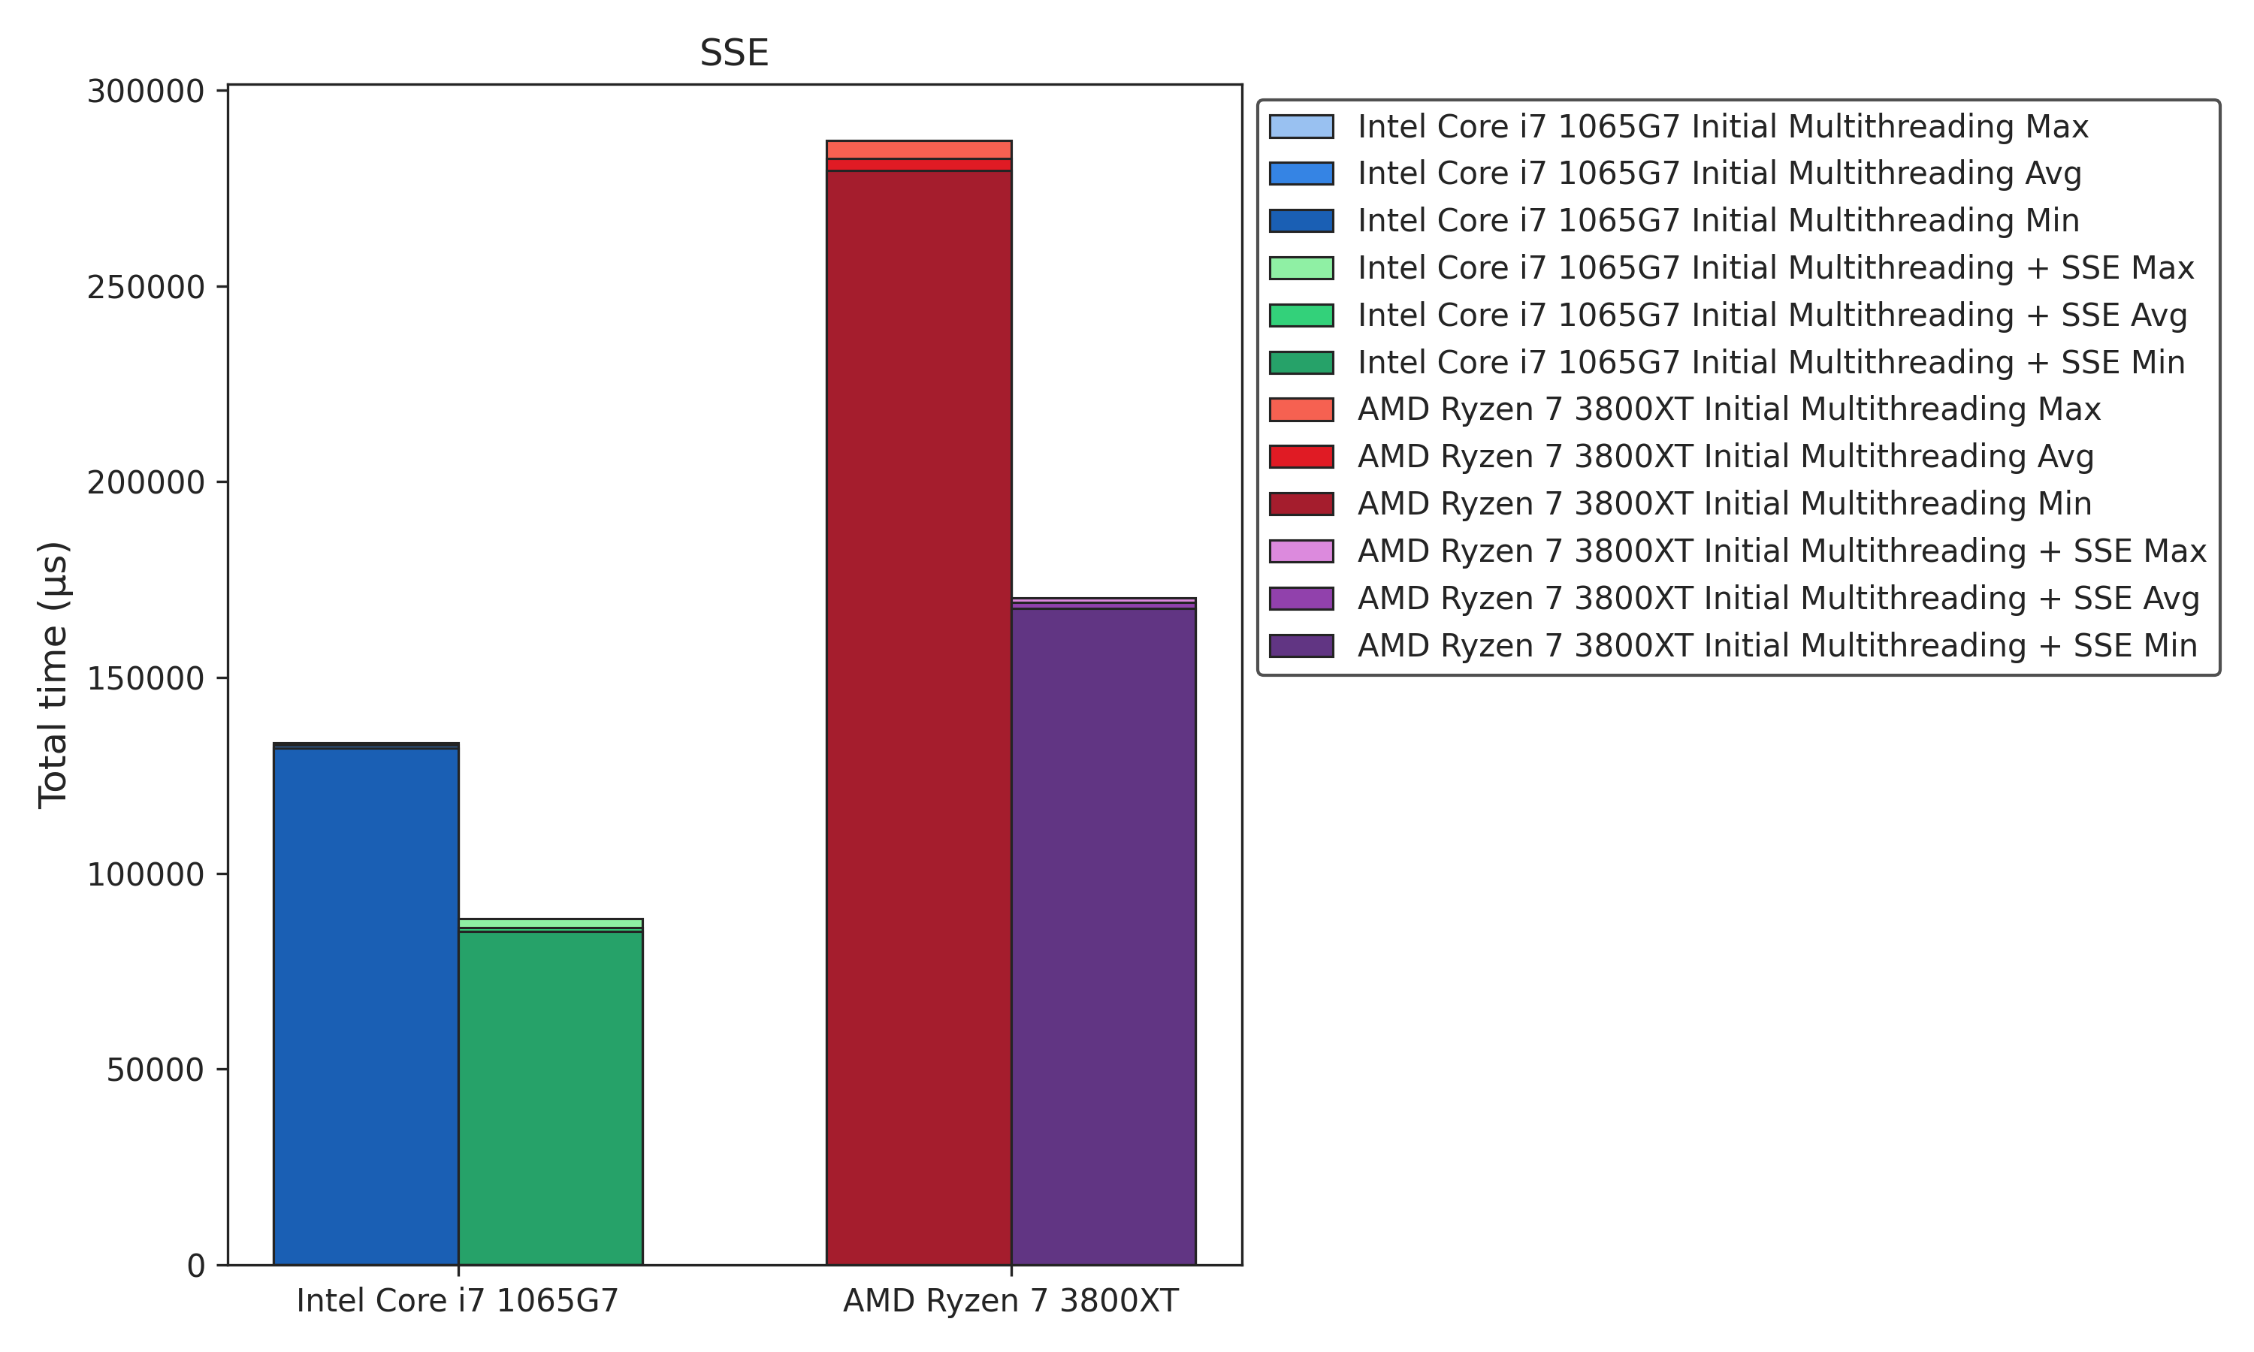
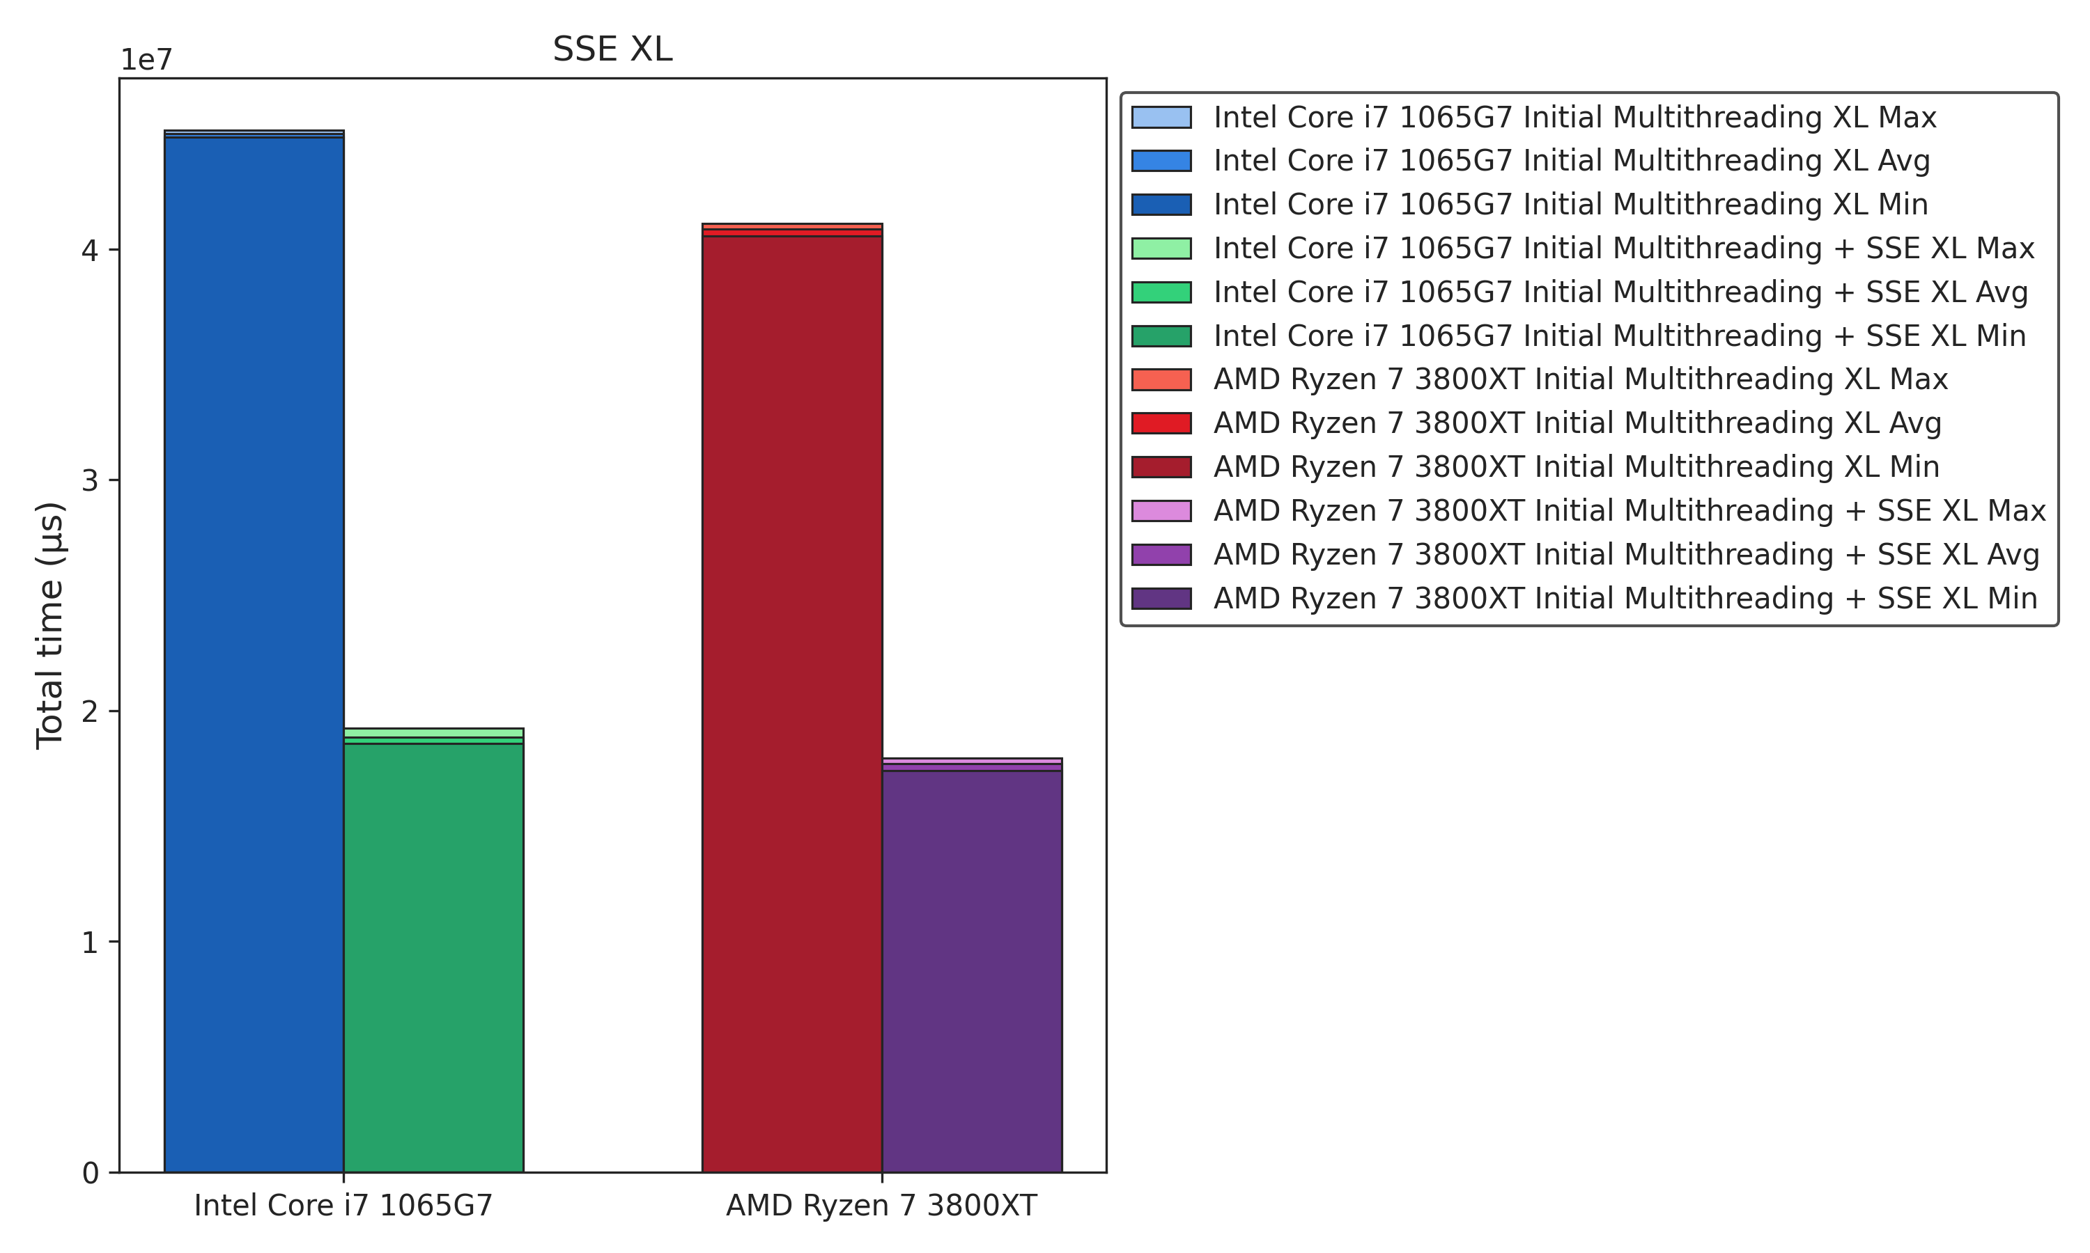
x86 Optimization
SSE Benchmarks
-39%
-57%

Slide 36
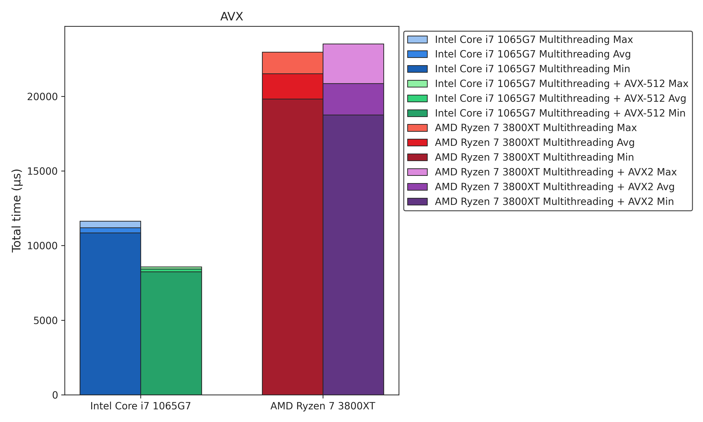
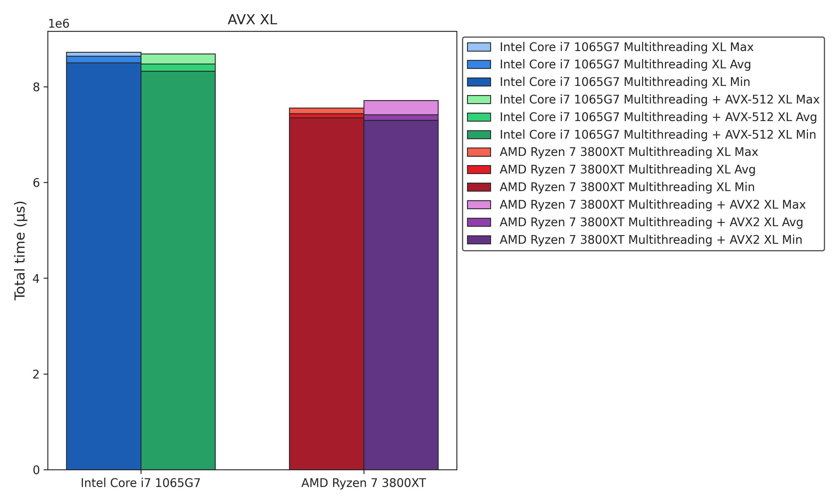
x86 Optimization
AVX Benchmarks
-10%
-1%

Slide 37
Quantization

Slide 38
Quantization
Overview
Date Type Optimization
Change: int8 for input values and int32 for intermediate results
Benefit: Achieving higher efficiency with a minimal reduction in accuracy (decreasing by 5% to 8%, resulting in approximately 90% accuracy)
SIMD Integration
Change: Added mixed data type support in AVX2, AVX-512 and Arm Neon Code
Issue: AMX does not support int8
Benefits: Process even more elements in parallel, significantly boosting computing speed
Memory Reduction
Change: Model size reduced (~15 %)
Issue: Multithreading memory overhead
Benefit: Frees up memory on resource-limited devices
Benchmark | Bytes
NO_SIMD | 2,409,961
NO_SIMD_INT | 2,050,771

Slide 39
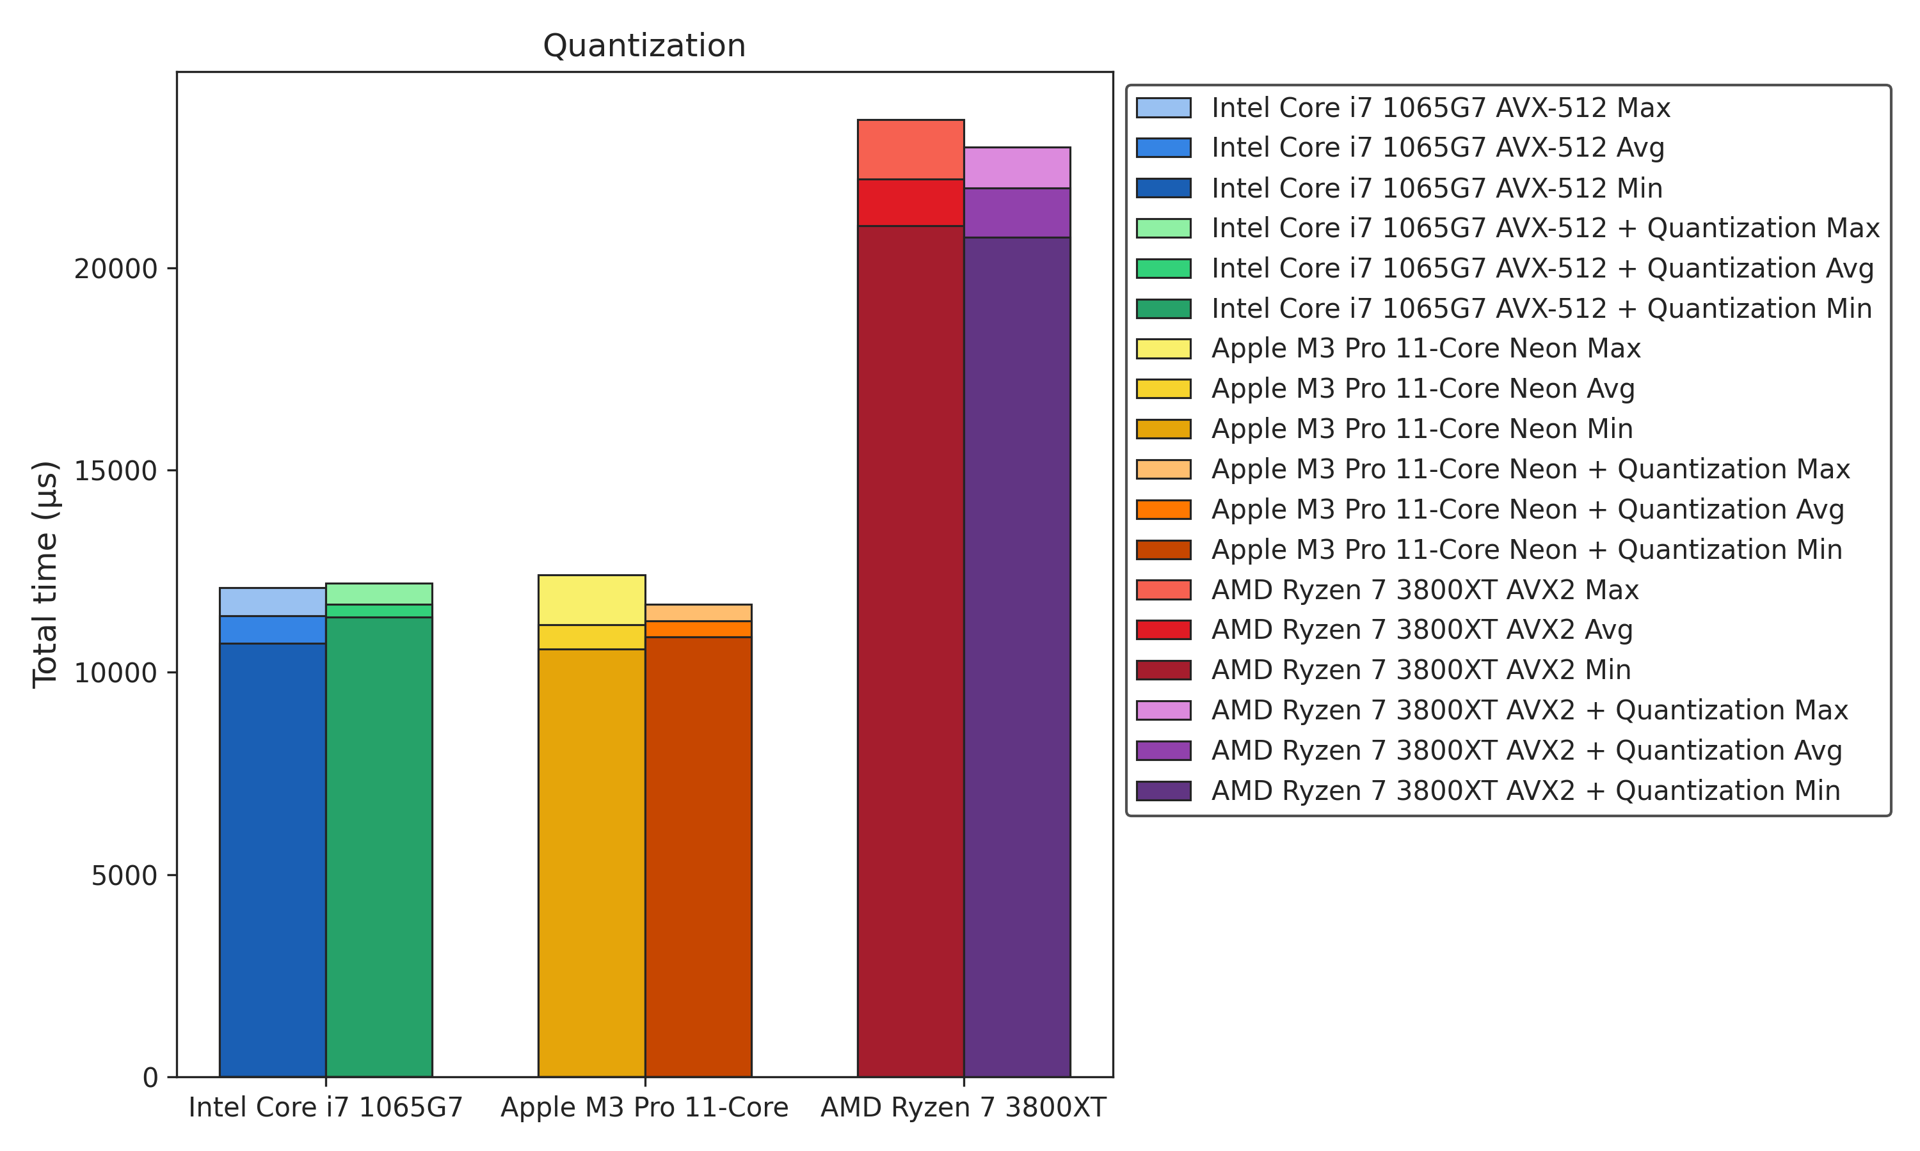
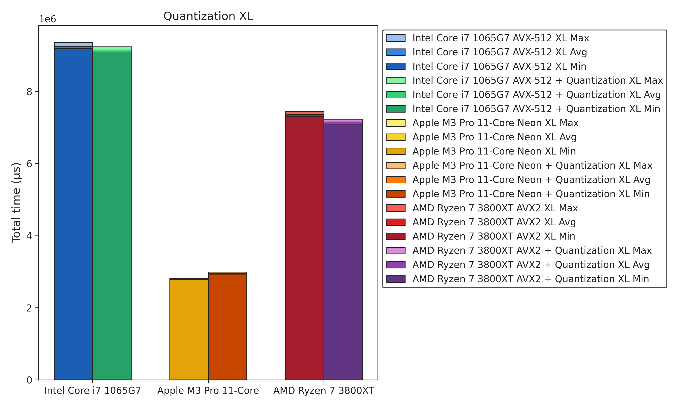
Quantization
Benchmarks
+/-0%
-1%

Slide 40
Other Optimizations

Slide 41
Other Optimizations
Codebase Migration
Migrated from C to C++ to resolve extern "C" compatibility issues
Facilitated seamless integration with CUDA
Performance Optimization
Adopted flat array representation for better cache utilization and easier CUDA integration
Optimized memory allocation by relocating memory requests outside of loops to enhance performance
Data Preprocessing
Pre-transposed fc_bias and fc_weights to avoid repeated transposing
Code Efficiency Improvements
Removed unused functions to reduce complexity and binary size
Integrated transpose directly into flatten to speed up data processing
Code Optimization
Utilized Clang-specific and C++11 features to reduce boilerplate and enhance functionality
Modularized parallel frameworks (NVIDIA, OpenMP, Multithreading) for easier maintenance
Function Inlining
Inlined all functions to reduce call overhead

Slide 42
Inital vs. Final Benchmarks

Slide 43
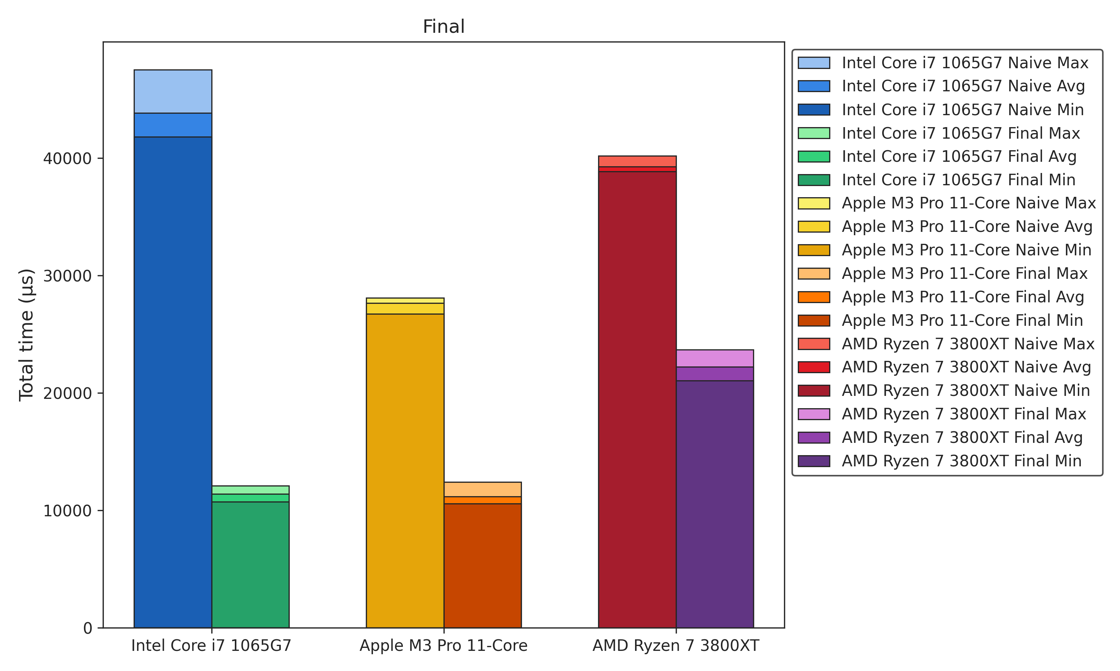
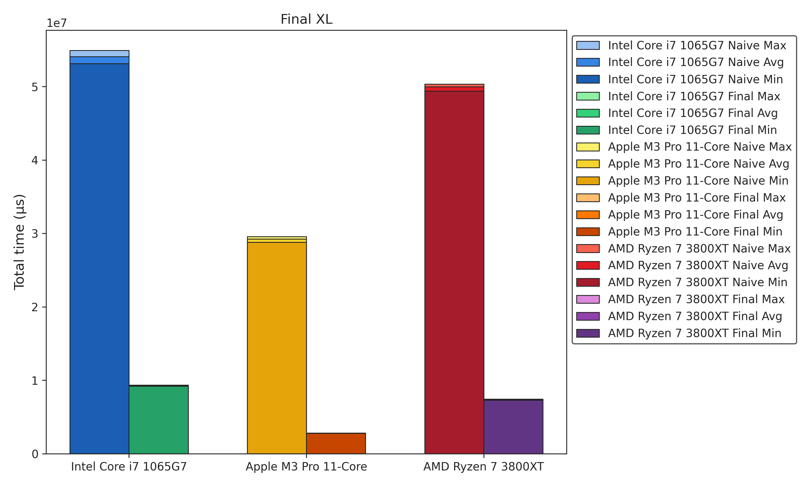
Inital vs. Final Benchmarks
-60%
-85%

Slide 44
GPU-Based Optimizations

Slide 45
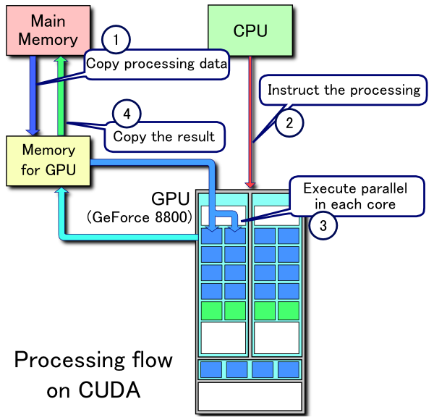
CUDA Tuning
Processing Flow
Data Preparation
Allocate memory on both CPU and GPU
Copy data from CPU memory to GPU memory
Kernel Launch
Instruct the GPU to run a CUDA Kernel, which defines the parallel computation
The CPU sets up the kernel parameters and sends execution commands to the GPU
Parallel Execution
Each GPU core executes its portion of the CUDA Kernel in parallel
High throughput is achieved by running thousands of lightweight threads simultaneously
Data Retrieval
Once the GPU finishes computation, copy the results back from GPU memory to CPU memory for further processing or storage

Slide 46
CUDA Tuning
CUDA Kernels
Definition
CUDA Kernels are functions that execute on the GPU in parallel across many lightweight threads
Thread Organization
Threads are grouped into blocks, and blocks form a grid
Each thread uses its unique IDs (threadIdx, blockIdx) to determine which part of the data it processes
Example Use Case: ReLU
In this example, each thread checks one element in a matrix and sets it to 0 if it’s negative
This operation can be performed across large matrices quickly by harnessing GPU parallelism
__global__ void relu_kernel(DATA_TYPE *matrix, int N, int M) {
int row = blockIdx.y * blockDim.y + threadIdx.y;
int col = blockIdx.x * blockDim.x + threadIdx.x;
if(row < N && col < M) {
if(matrix[row * N + col] < 0 ){
matrix[row * N + col] = 0;
}
}
}

Slide 47
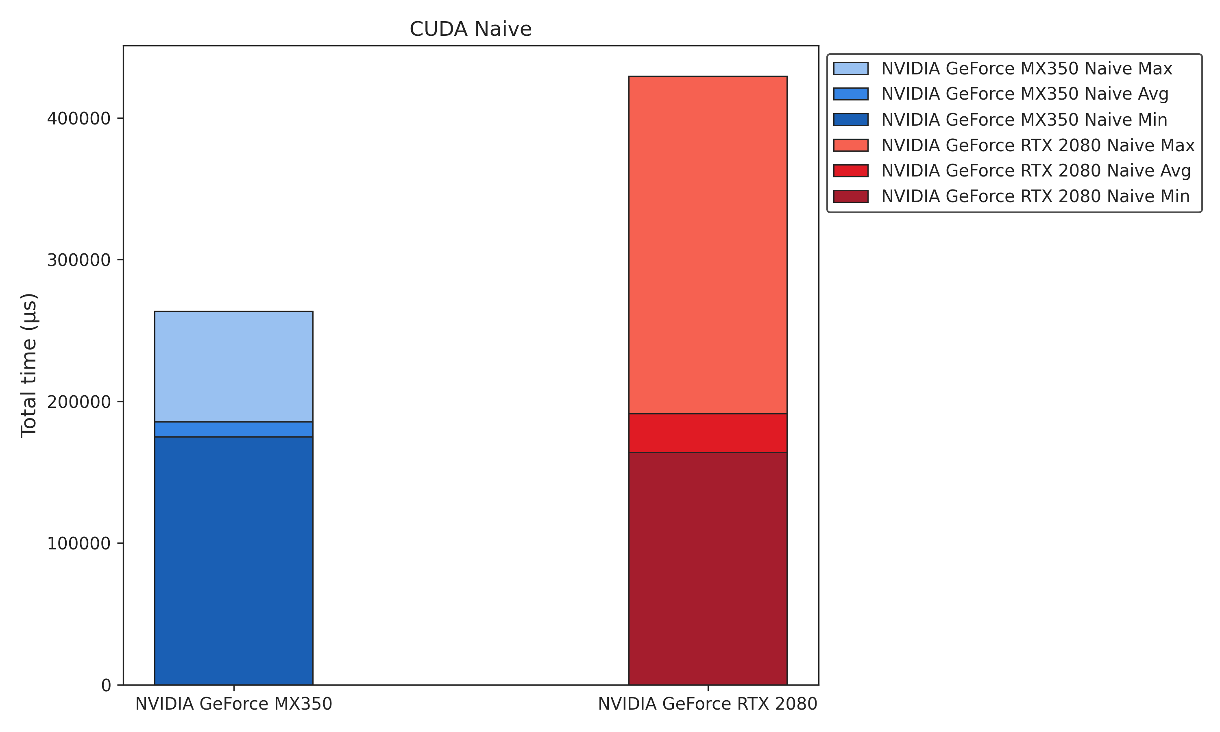
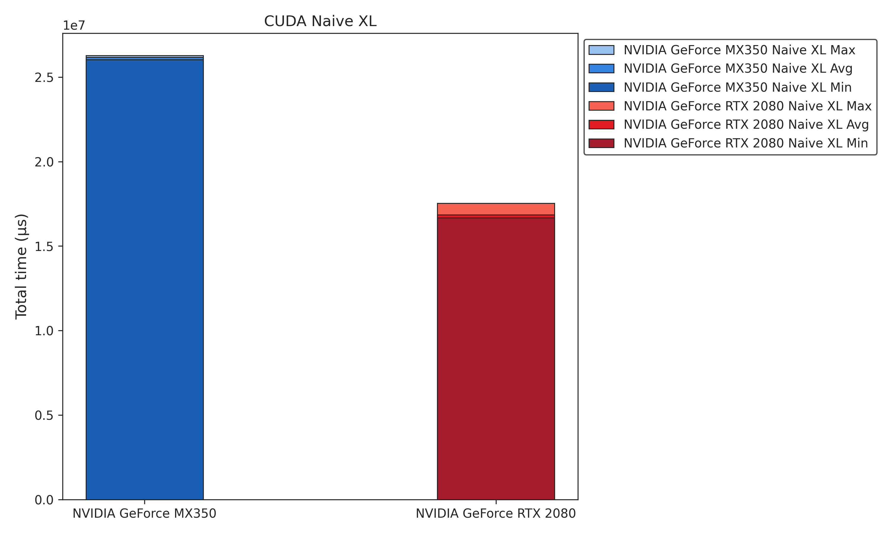
CUDA Tuning
Benchmarks

Slide 48
Reduced Memory Copy Overhead
Moved GPU memory copies of IO-matrices outside the main loop
Thread count
Increased the thread count to the maximum that is available for modern GPUs (1024)
matrix *add(matrix *a, matrix *b, matrix *c) {
if(c == NULL) {
c = malloc_matrix(a->x, a->y);
}
// Input
// ...
// IO-matrix
size_t bytes_b = K * L * sizeof(DATA_TYPE);
DATA_TYPE *d_bias;
cudaMalloc(&amp;d_bias, bytes_b);
cudaMemcpy(d_bias, b->m, bytes_b, cudaMemcpyHostToDevice);
long threads = 32;
dim3 block_dim(threads, threads);
// ...
add_kernel<<<grid_dim, block_dim>>>(d_matrix, d_bias, N, M, K);
cudaMemcpy(c->m, d_matrix, bytes_n, cudaMemcpyDeviceToHost);
// ...
}

Slide 49
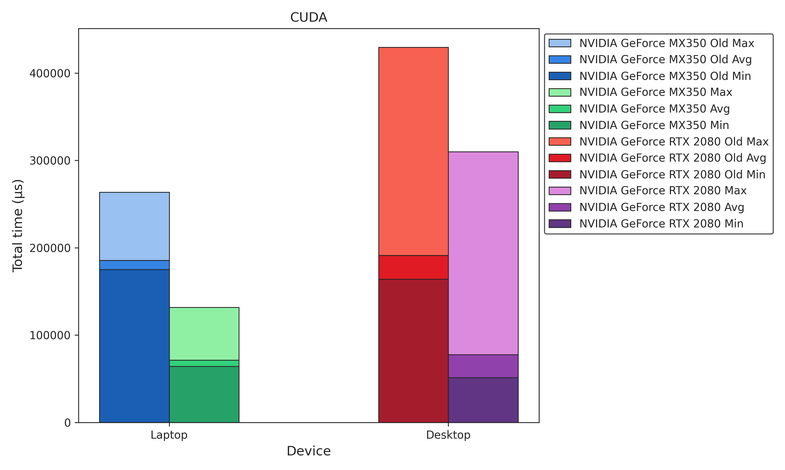
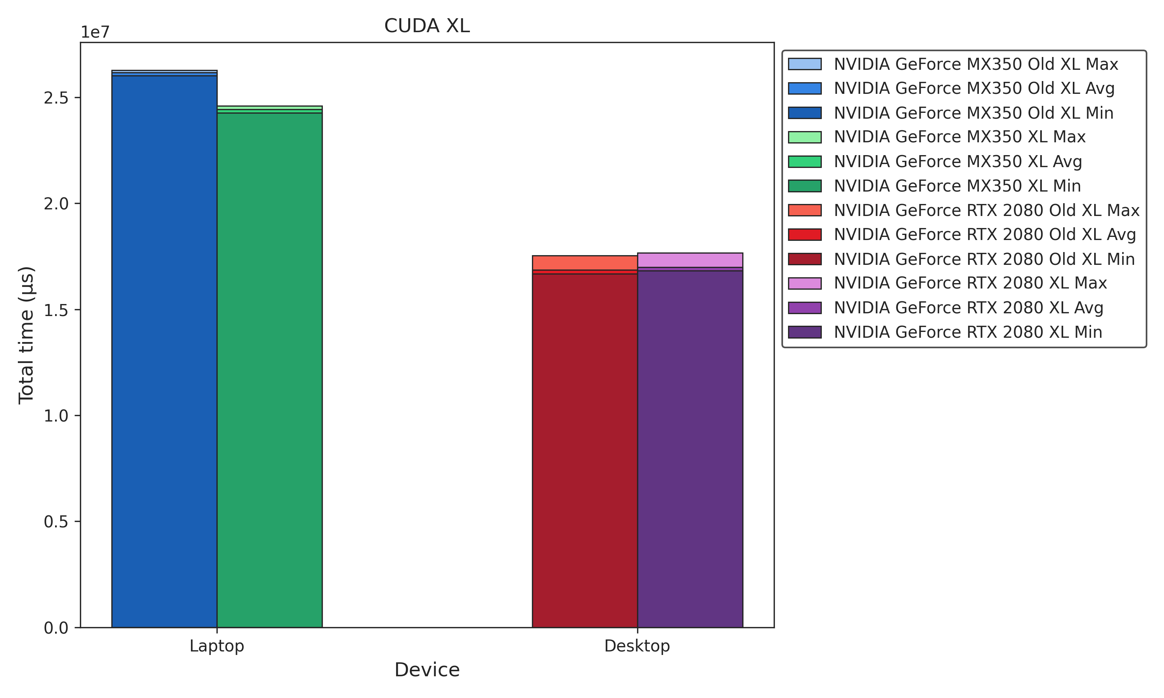
CUDA Tuning
Benchmarks
-61%
-4%

Slide 50
CUDA Tuning
Further Copy Overhead Reduction & Constant Memory
Eliminating Copy Overheads
IO matrices are transferred to the GPU before computation begins
Intermediate result matrices are pre-allocated
Copy operations occur only at the start and end — no data is copied during computation
Implemented Constant Memory for Convolution
Fast Access: Data in constant memory is cached, enabling rapid access
Efficient Bandwidth: Reduces global memory traffic, improving performance
Consistency: Ideal for read-only data that remains constant across computations
#define NUM_MASKS (4)
#define MASK_SIZE (3)
__constant__ DATA_TYPE c_masks[NUM_MASKS][MASK_SIZE][MASK_SIZE];
void init_const_memory(matrix **masks) {
DATA_TYPE h_masks[NUM_MASKS][MASK_SIZE][MASK_SIZE];
for (int i = 0; i < NUM_MASKS; i++) {
for (int l = 0; l < MASK_SIZE; l++) {
for (int k = 0; k < MASK_SIZE; k++) {
h_masks[i][l][k] = masks[i]->m[l * MASK_SIZE + k];
}
}
}
cudaMemcpyToSymbol(c_masks, h_masks, sizeof(h_masks));
}

Slide 51
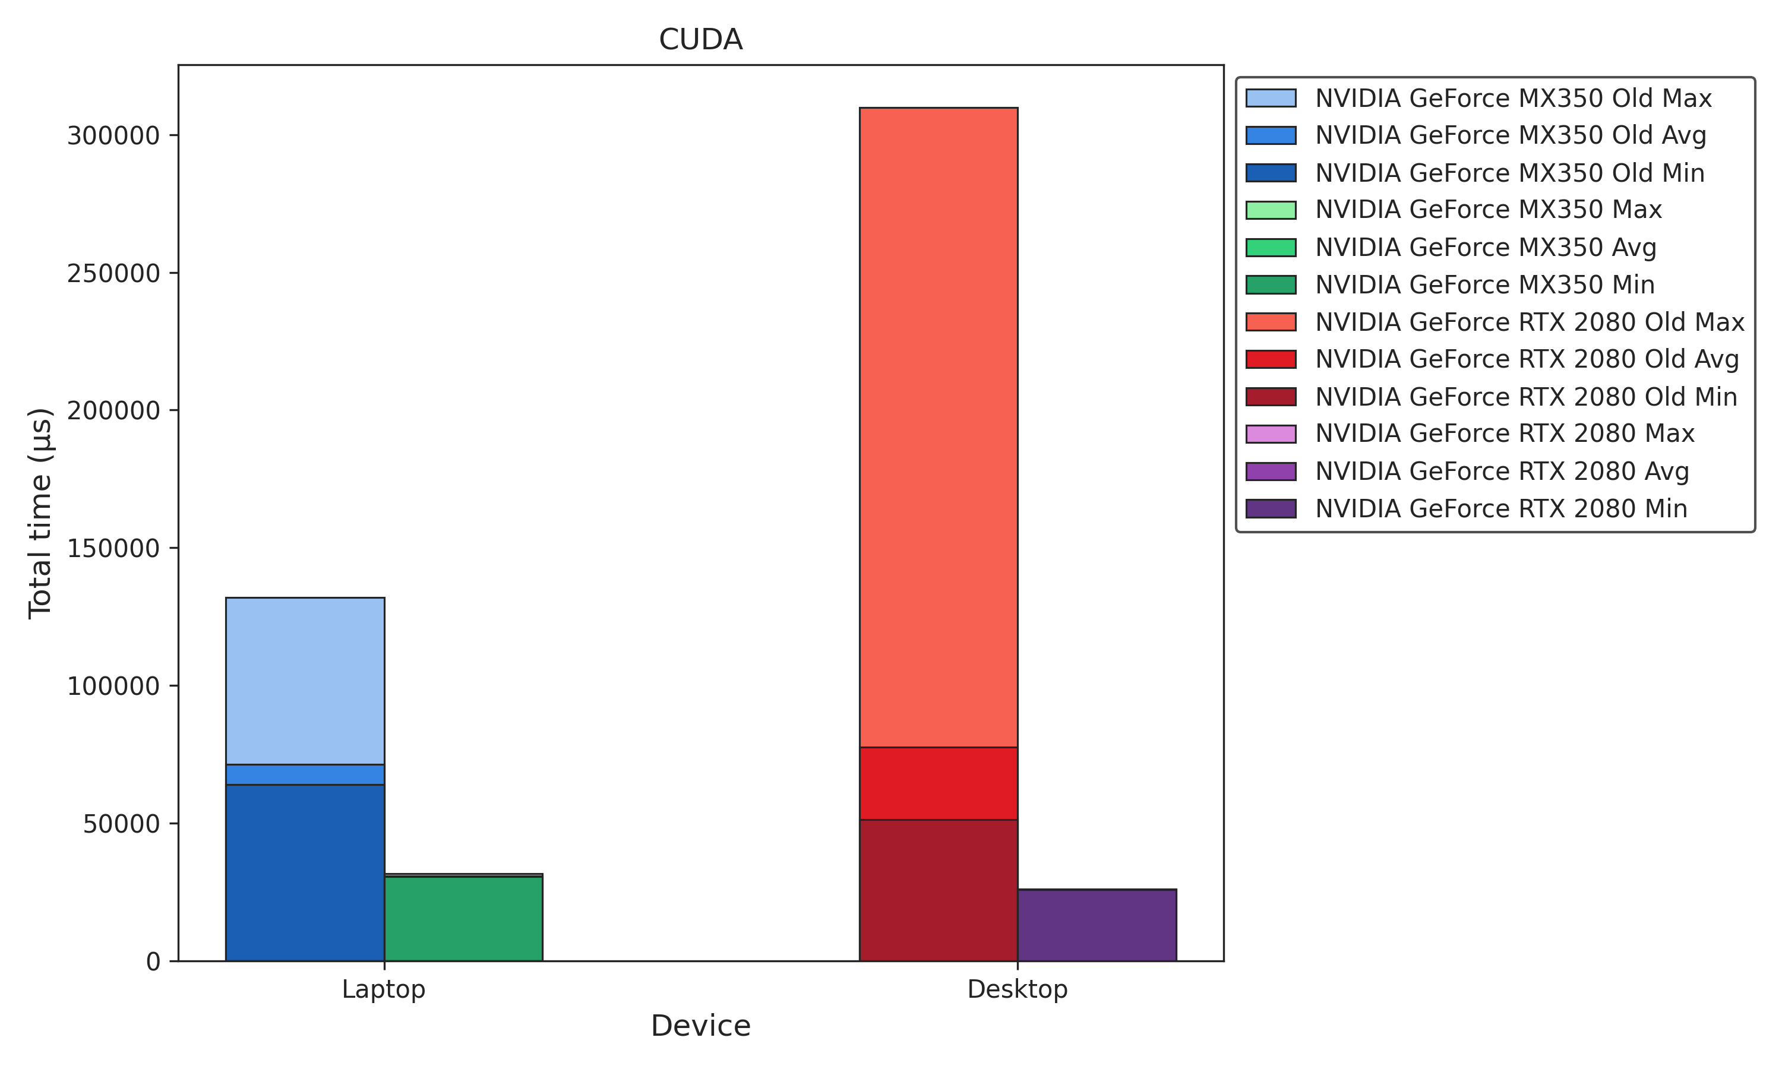
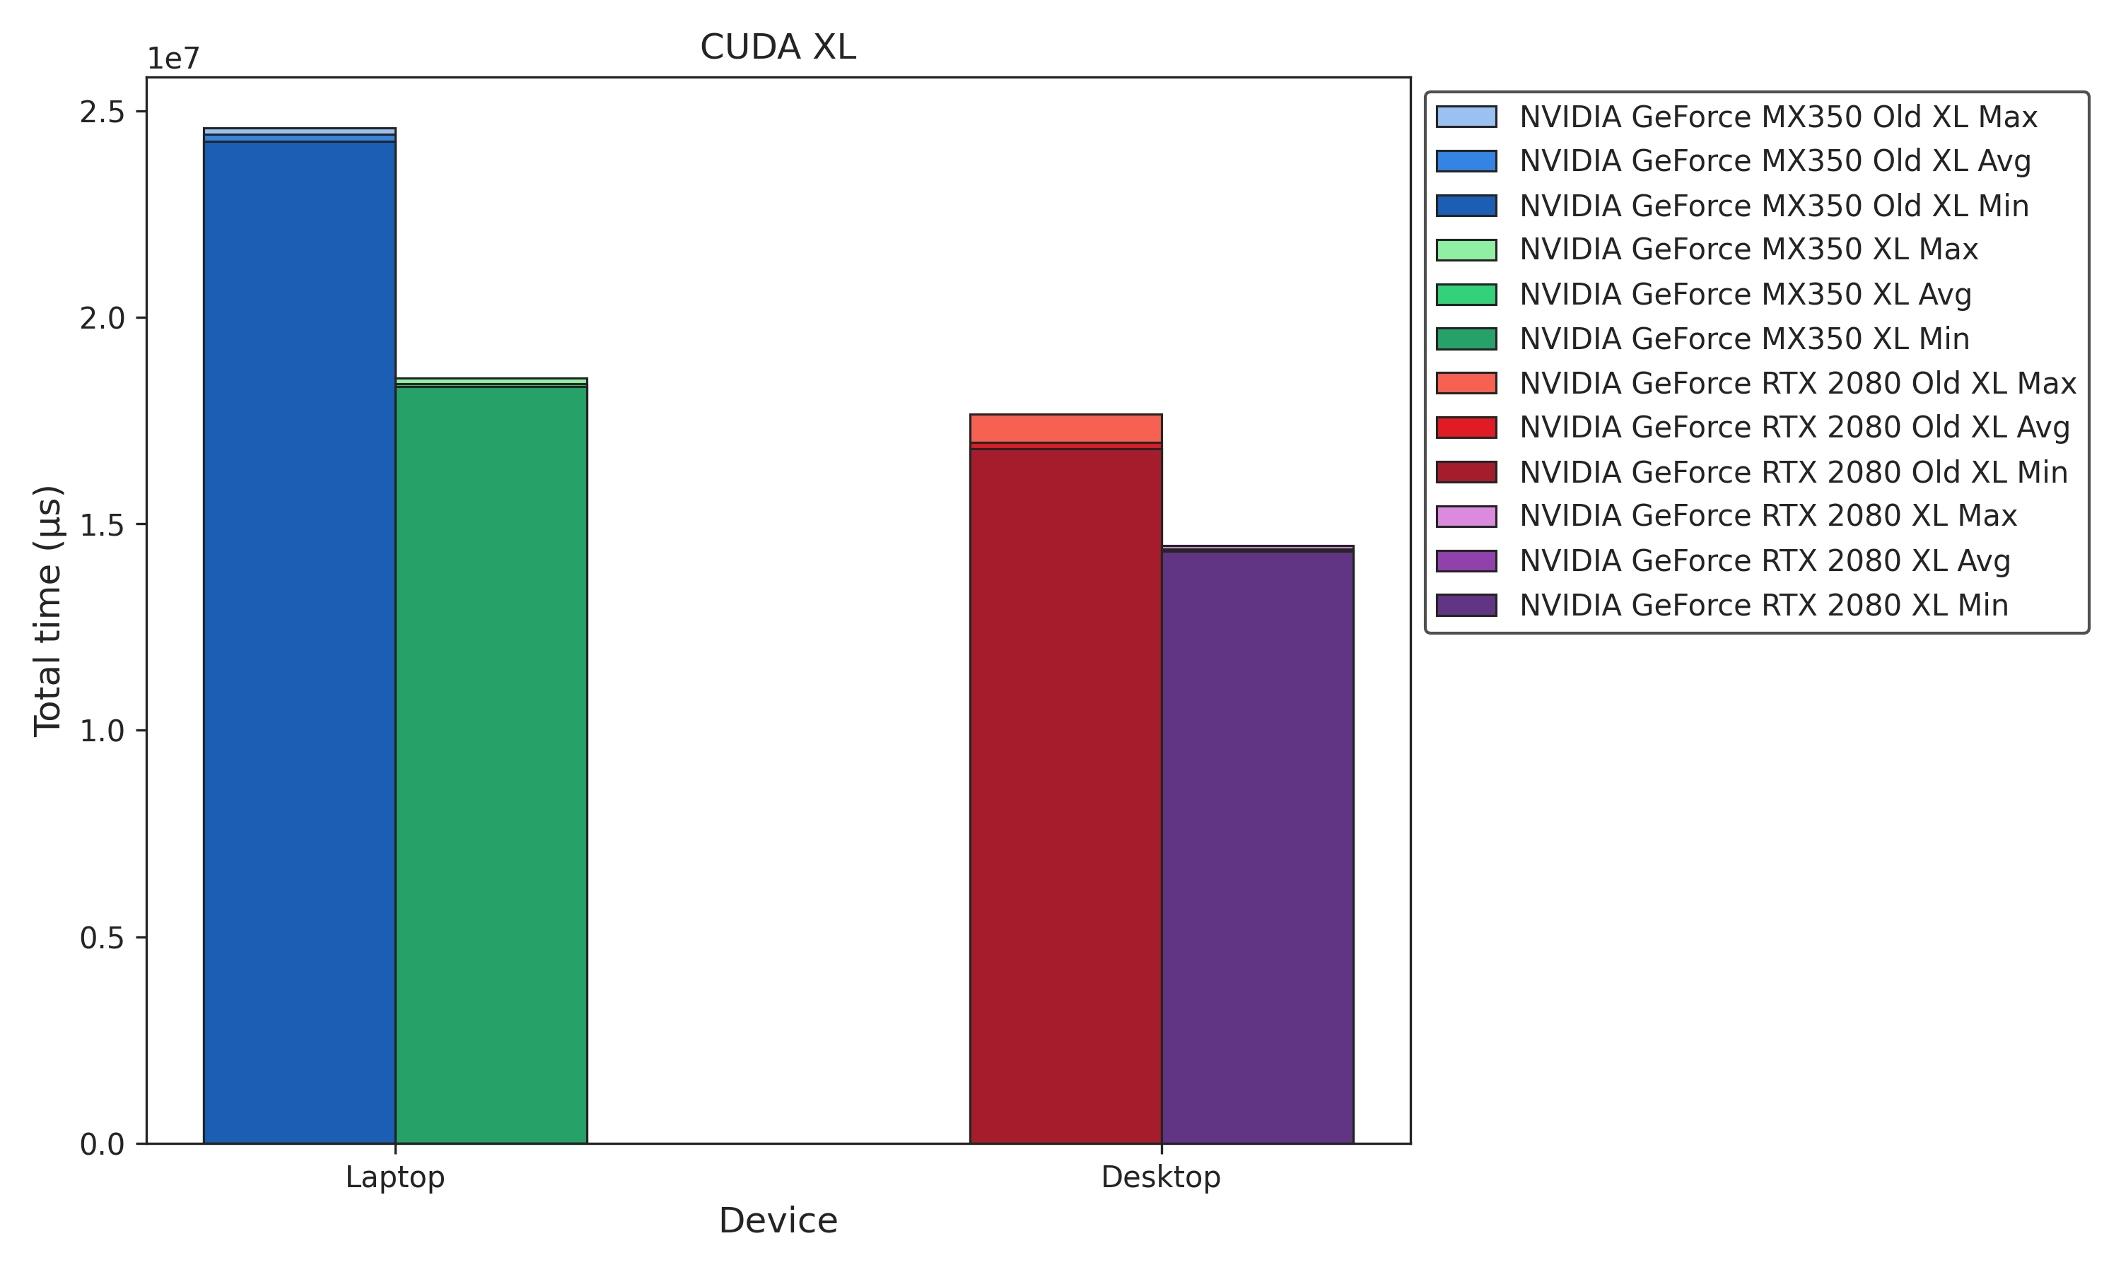
CUDA Tuning
Benchmarks
-62%
-21%

Slide 52
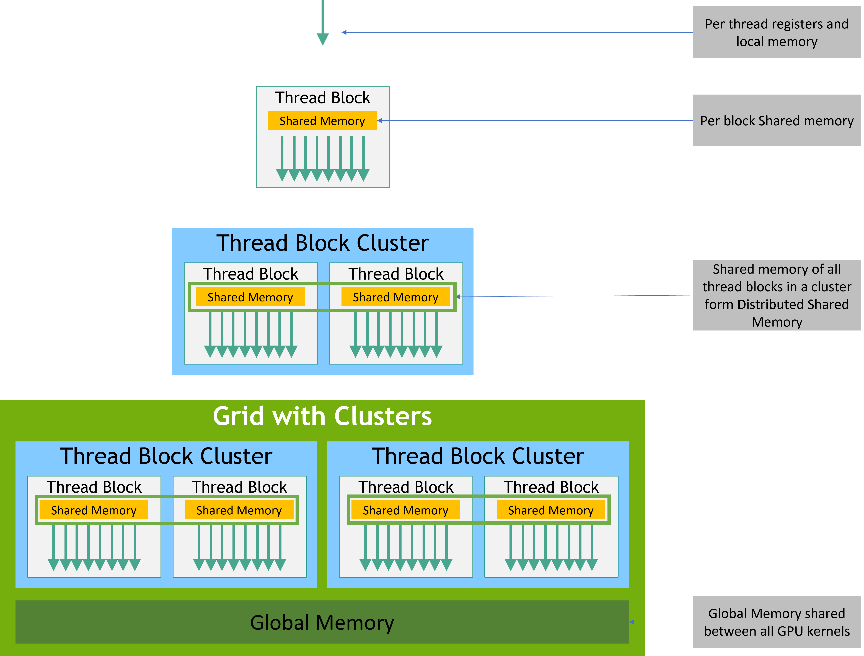
CUDA Tuning
Removing Unnecessary Operations & Introducing Shared Memory
Eliminated Transpose Overhead
Weights are stored in a cache-optimized layout, removing the need for a transpose
Transpose was causing a significant performance penalty
Shared Memory for Matmul XL
Shared Memory
A small, on-chip memory accessible by all threads in a block
It’s much faster than global memory, making it ideal for frequently accessed data
Benefits
Reduces global memory accesses.
Speeds up repeated data usage.
Improves performance especially for large-scale (XL) matrix multiplications.

Slide 53
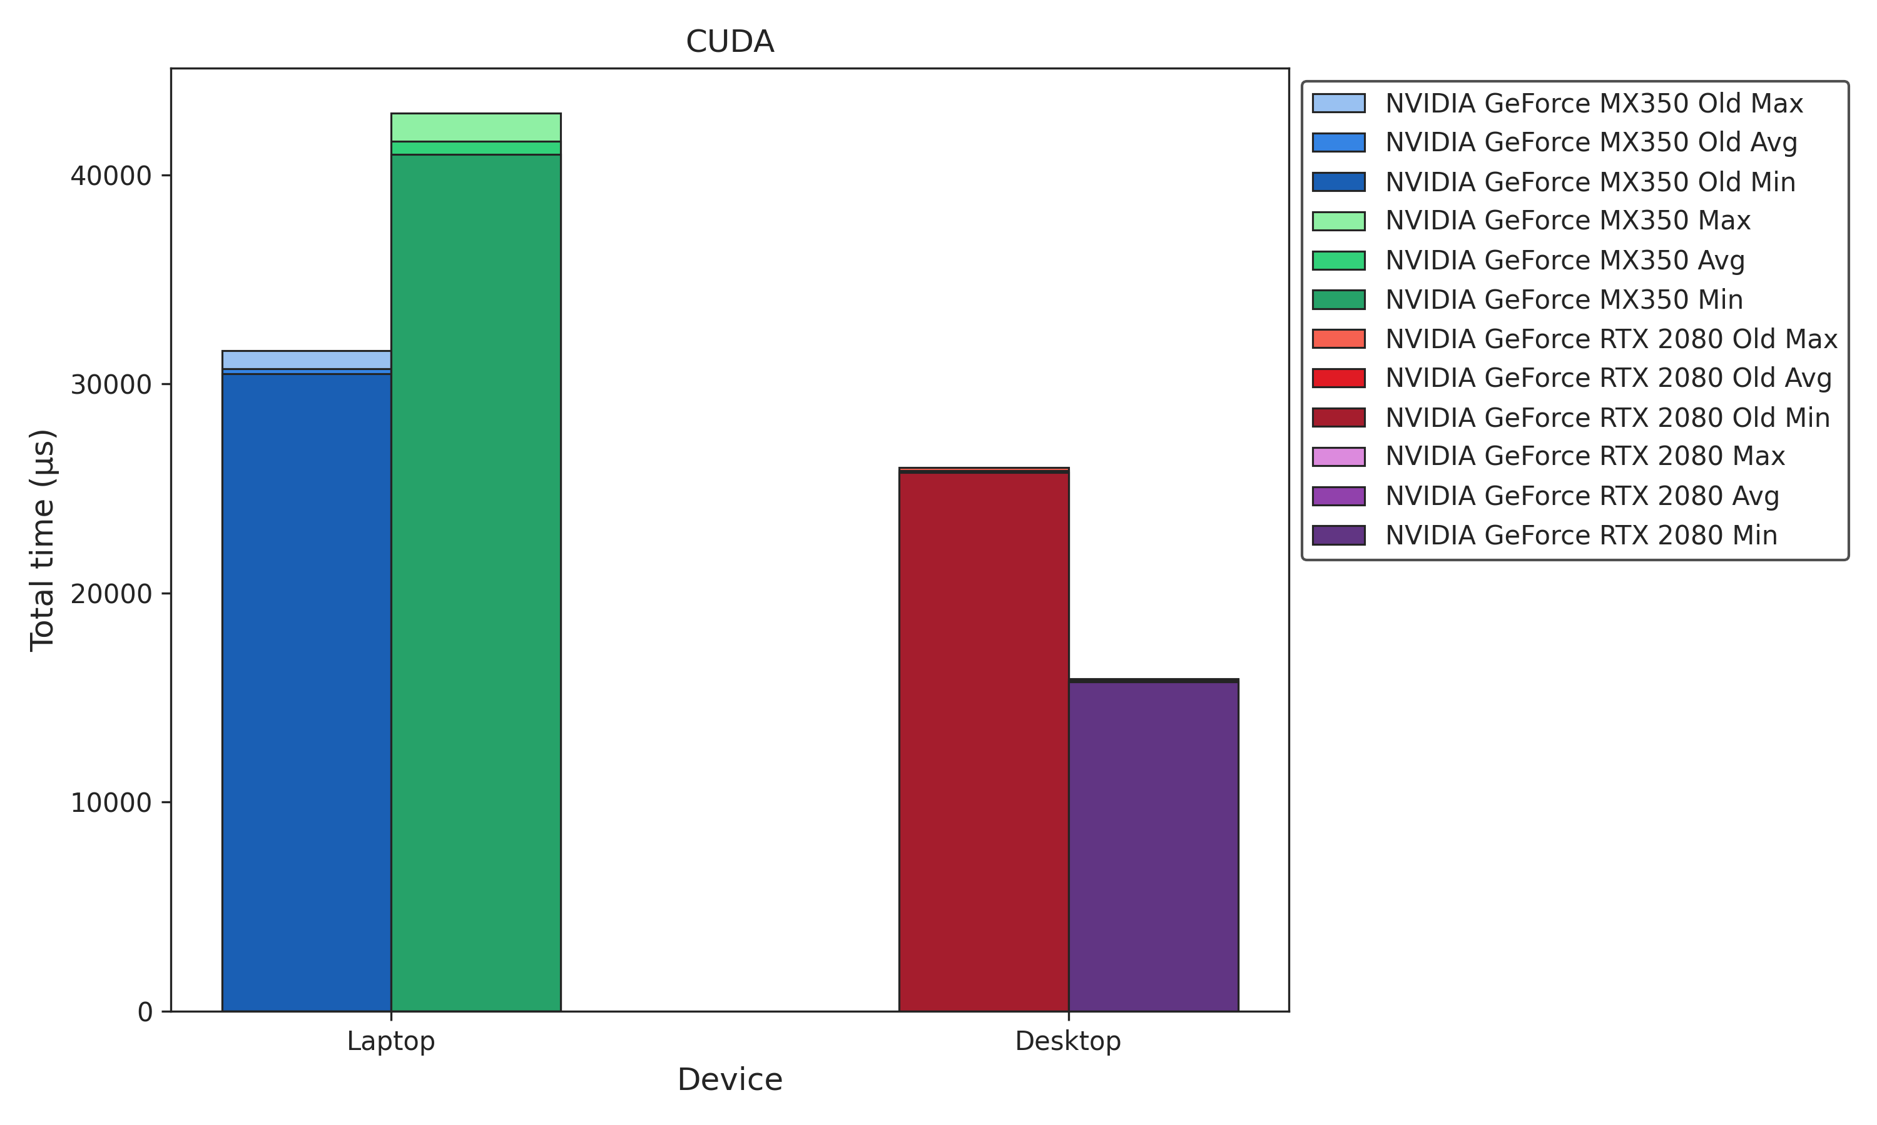
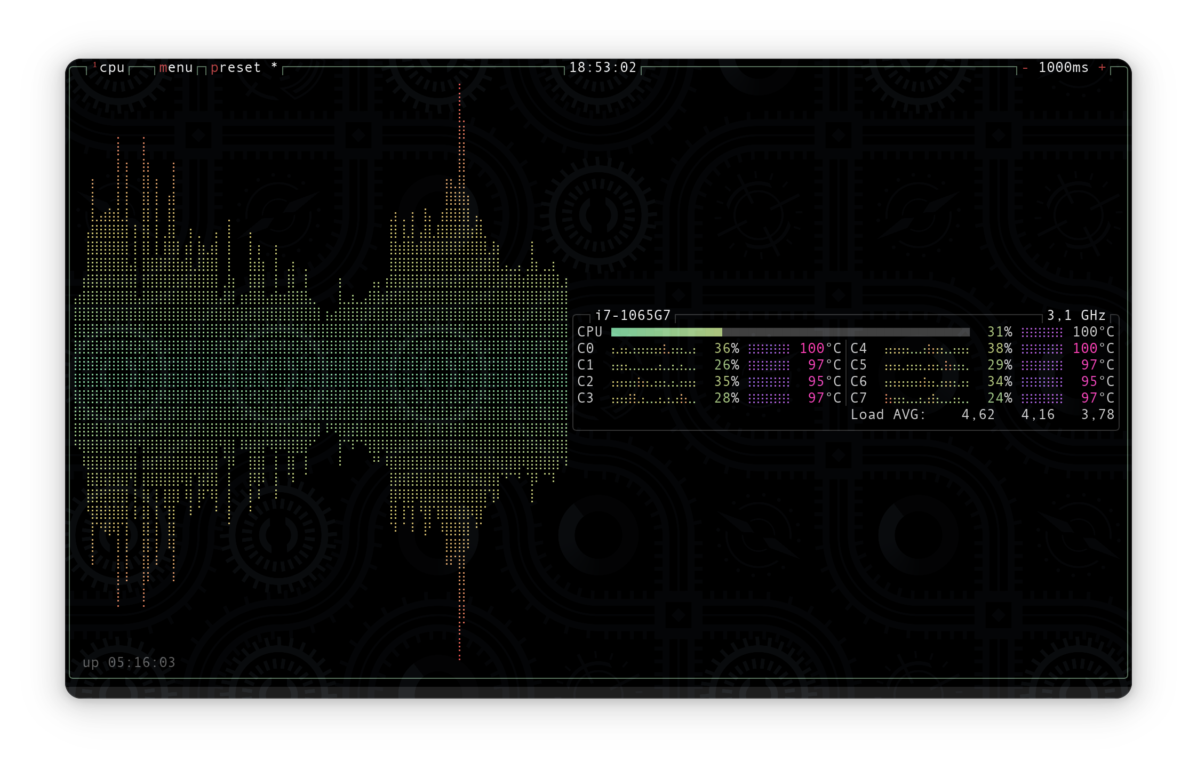

CUDA Tuning
Benchmarks
+2%

Slide 54
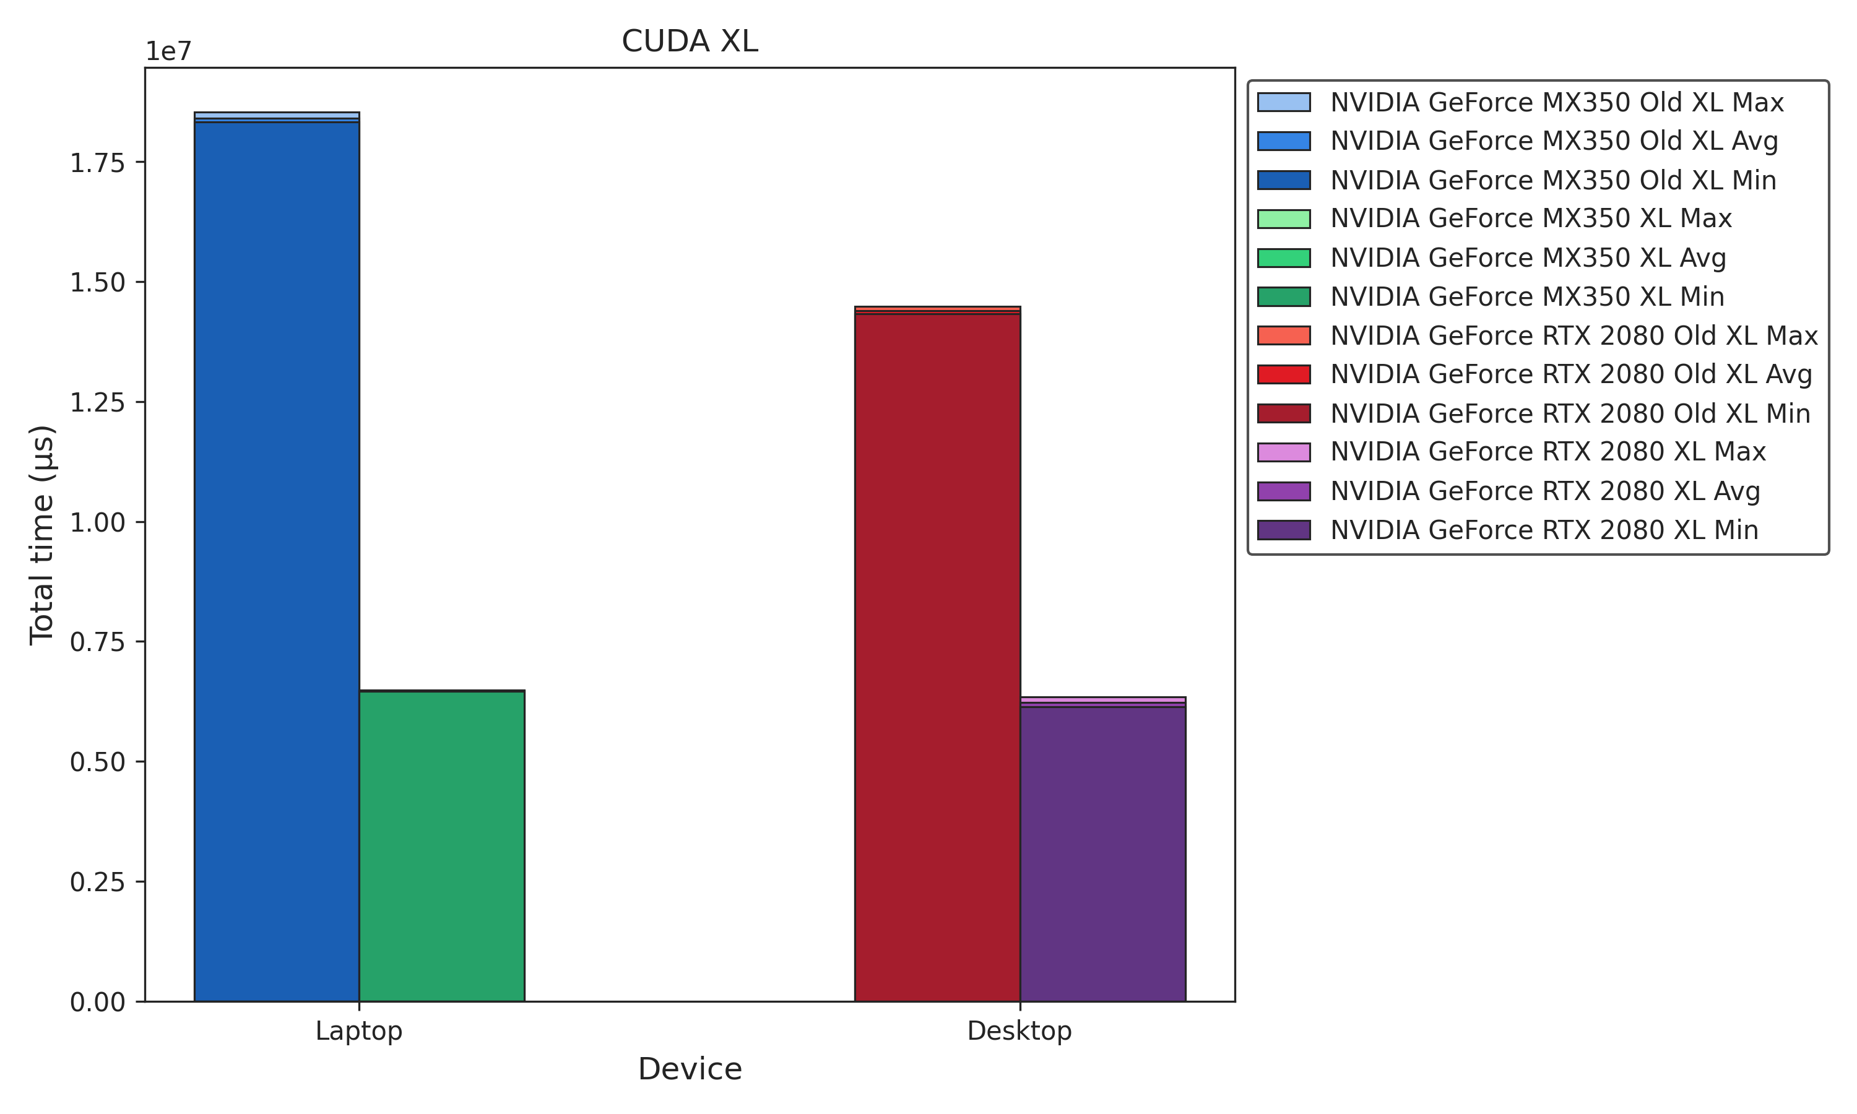
CUDA Tuning
Benchmarks
+2%
-61%

Slide 55
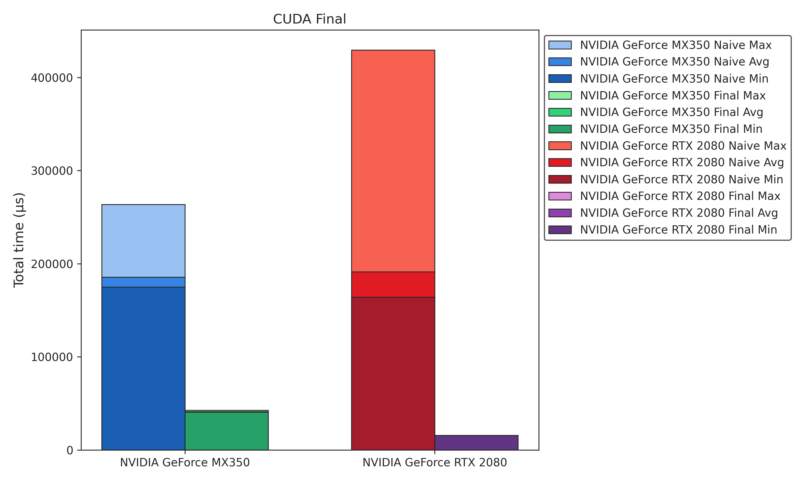
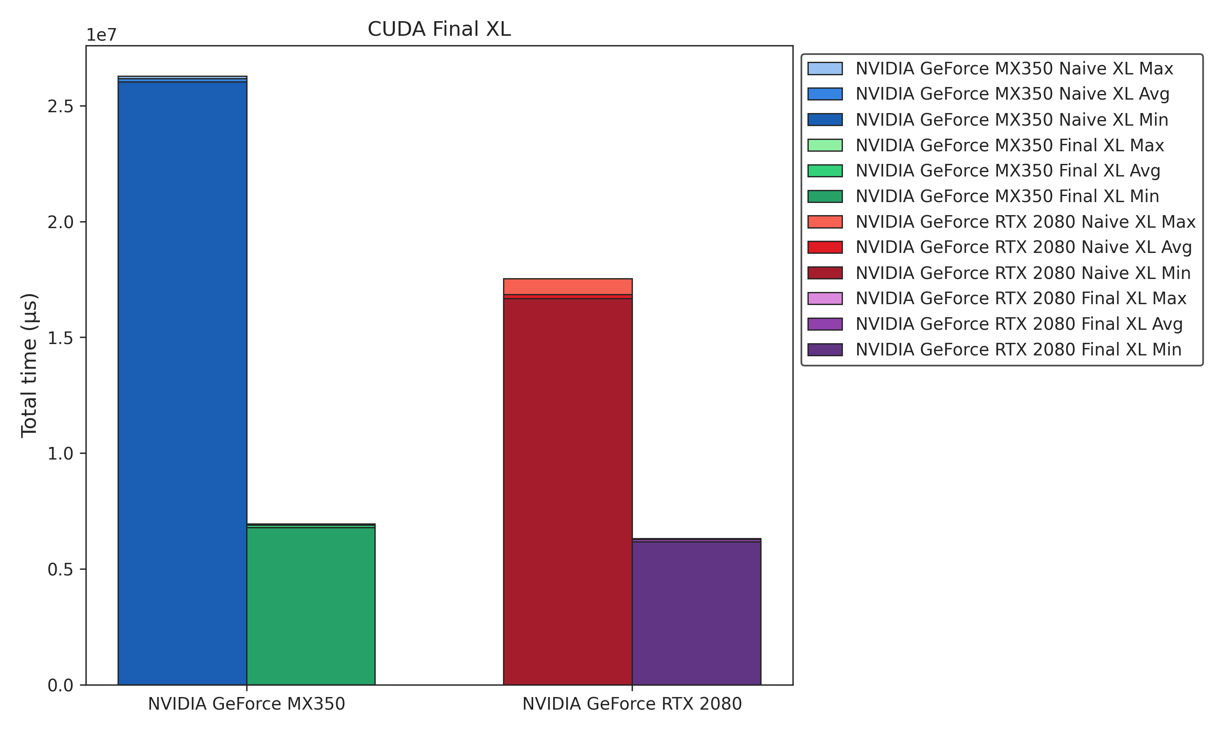
CUDA Tuning
Inital vs. Final Benchmarks
-78%
-74%

Slide 56
CPU vs. GPU

Slide 57
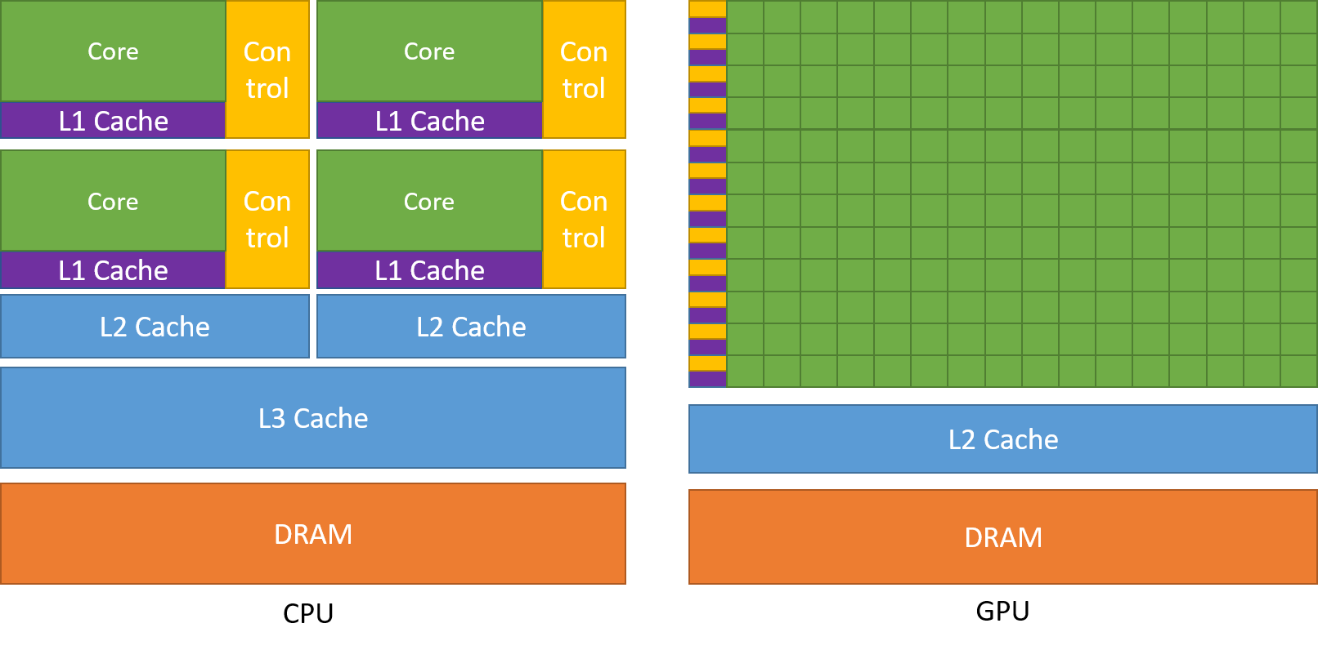
CPU vs. GPU
CPU
Optimized for sequential tasks
Many transistors dedicated to control flow and caching mechanisms
Relies on large caches and complex flow control to handle memory latency
GPU
Optimized for parallel data processing
Most transistors dedicated to computations
Hides memory latency by performing more computations concurrently

Slide 58
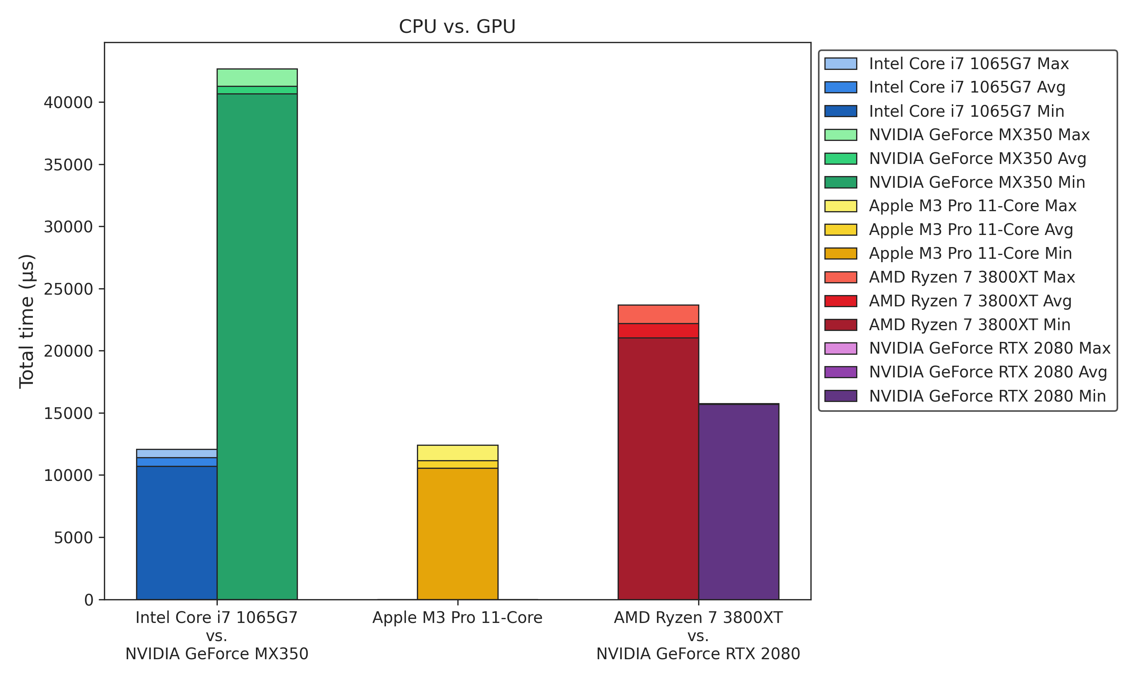
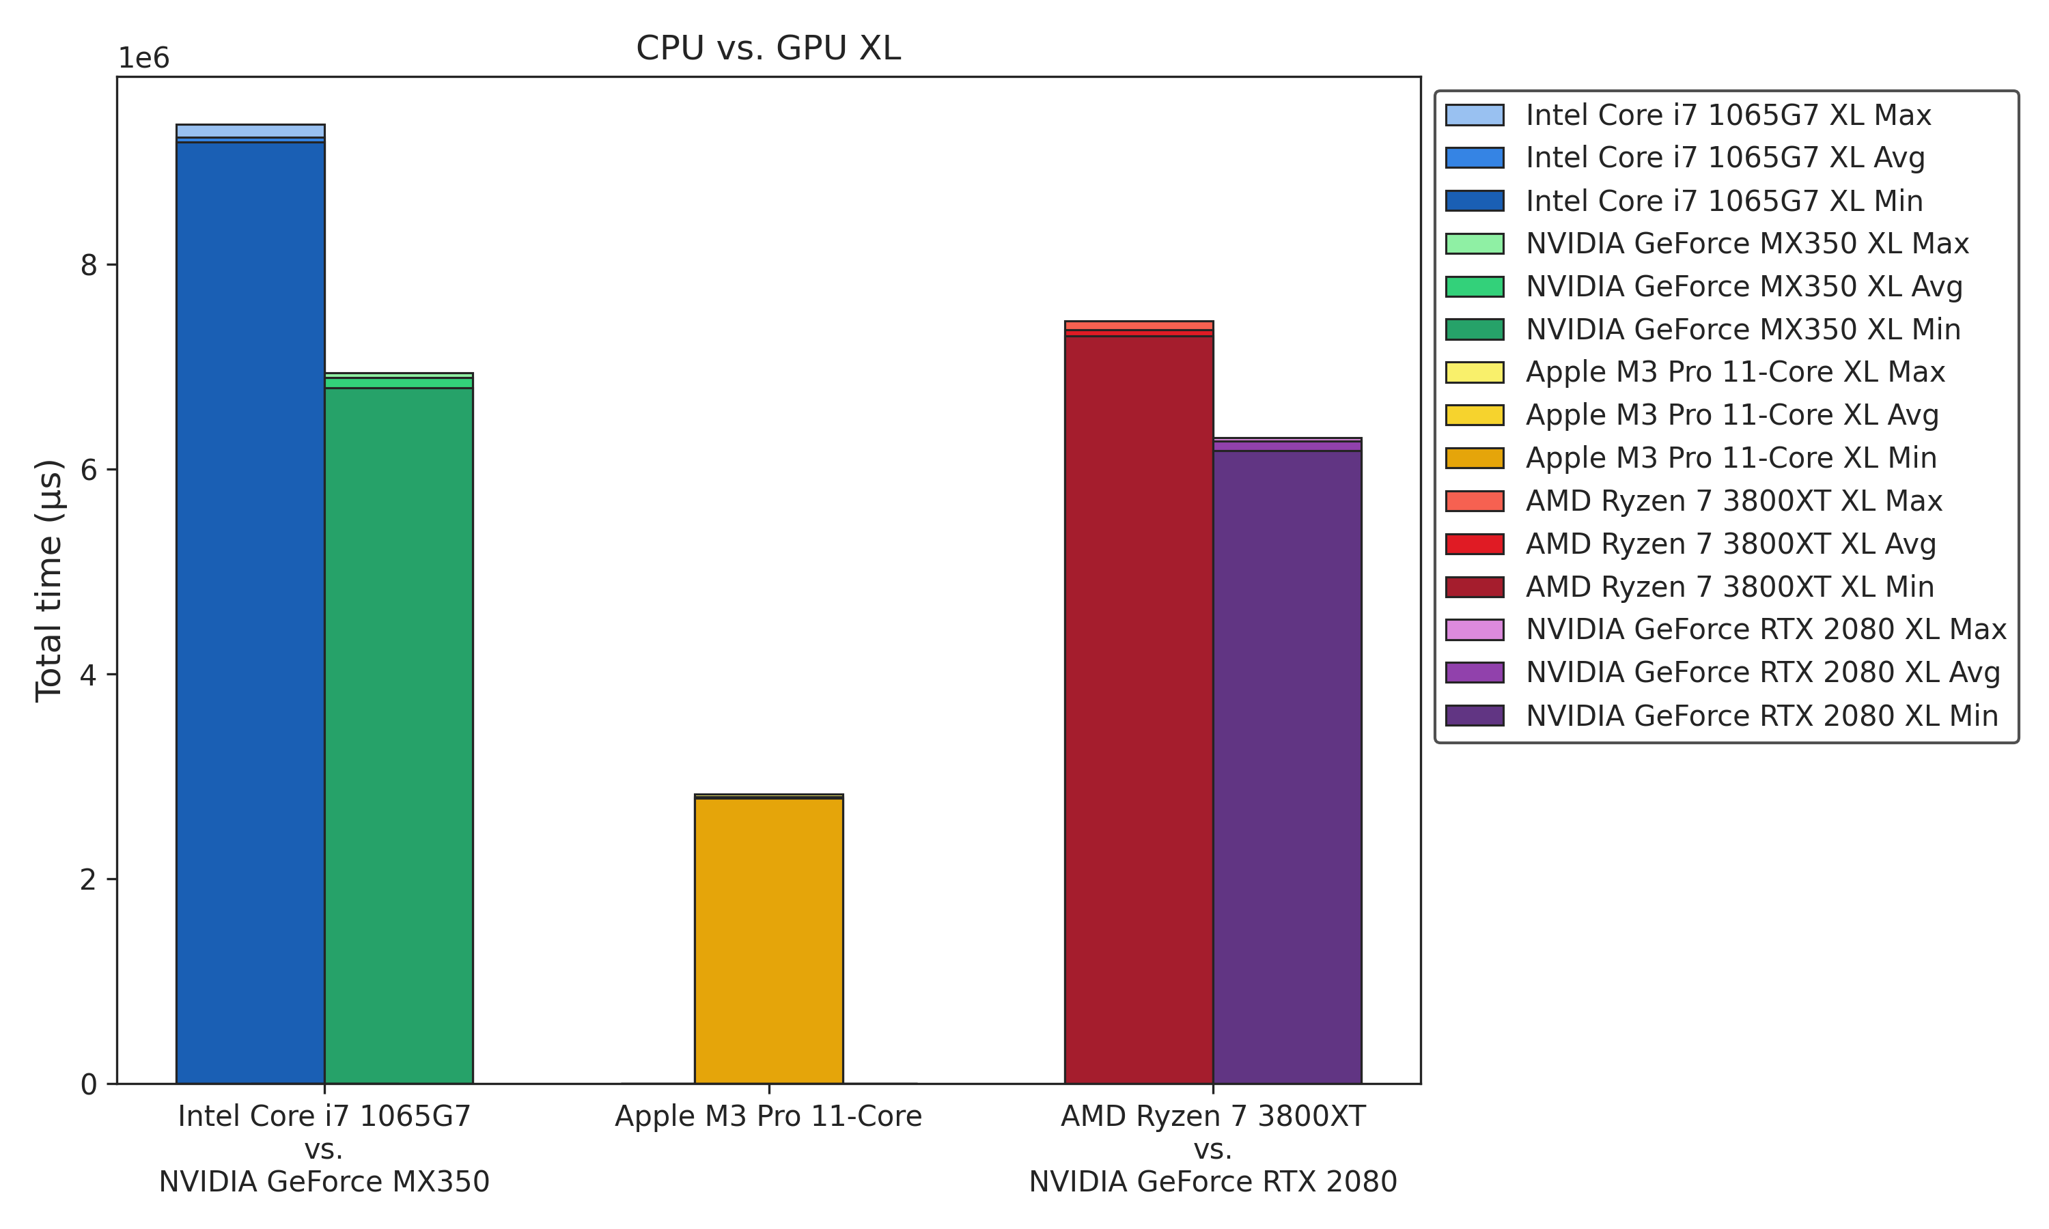

CPU vs. GPU
Benchmarks
+52%
-18%

Slide 59
Picture Credits
p. 1: https://www.avg.com/de/signal/cpu-vs-gpu-comparison
p. 9: https://en.wikipedia.org/wiki/Multithreading_(computer_architecture)
p. 10: https://pixabay.com/de/illustrations/statistiken-gesch%C3%A4ft-graph-daten-5041374/
p. 16, 18: https://doku.lrz.de/openmp-shared-memory-and-device-parallelism-11481693.html
p. 21: https://www.intel.com/content/www/us/en/developer/tools/oneapi/overview.html
p. 21: https://llvm.org/
p. 28: https://en.wikipedia.org/wiki/Single_instruction,_multiple_data
p. 29: https://documentation-service.arm.com/static/6530e5163f12c06bc0f74108
p. 33: https://xkcd.com/2347/
p. 34: https://en.wikipedia.org/wiki/Streaming_SIMD_Extensions
p. 45: https://en.wikipedia.org/wiki/CUDA
p. 52: https://docs.nvidia.com/cuda/cuda-c-programming-guide/index.html
p. 53: https://www.nytimes.com/2016/08/06/arts/this-is-fine-meme-dog-fire.html
p. 57: https://docs.nvidia.com/cuda/cuda-c-programming-guide/index.html
p. 58: https://imgflip.com/memegenerator/Table-Flip-Guy

Slide 60

Compiler
GCC vs. Clang
Feature | GCC | Clang
Performance | Generally considered highly optimized with mature optimizations | Competitive performance, sometimes faster than GCC in certain benchmarks
Optimization | Extensive optimizations options (e.g. O1. O2, O3 flags) | Similar set of optimizations, sometimes better diagnosctics (clang-tidy) and debugging (clang-analyzer) support
Native Thread Support | ✅ | ✅
OpenMP Support | ✅ | ✅
Use Cases | Widely used in embedded systems, scientific computing, Linux distributions | Preferred in environments like macOS, iOS, Android (via Google‘s Android NDK)
Debugging | GDB: Stable and well-optimized | LLDB: Faster start-up time, part of the LLVM project
License | GPL v3 | Open Source (Apache License 2.0)

